Slide 1
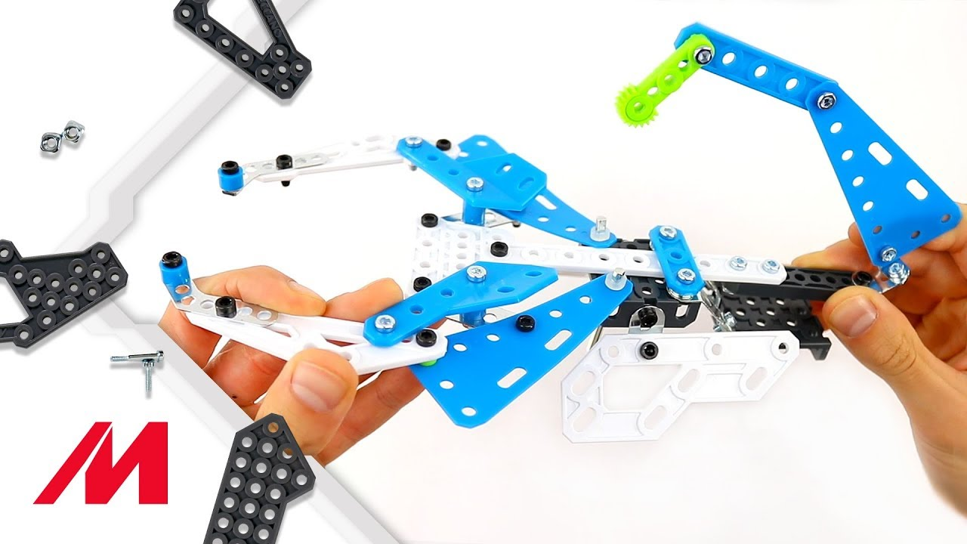
Meccano 19601 blue print 1 – scorpion

Slide 2
Why these pics?
The original Meccano video is on YouTube:
  https://www.youtube.com/watch?v=nVaHNqcVYqg
The video is too fast and sometimes lacks key views on how to build the model.
So, we downloaded the video, made screenshots and assembled them to this presentation.
It’s not perfect ;-)

Slide 3
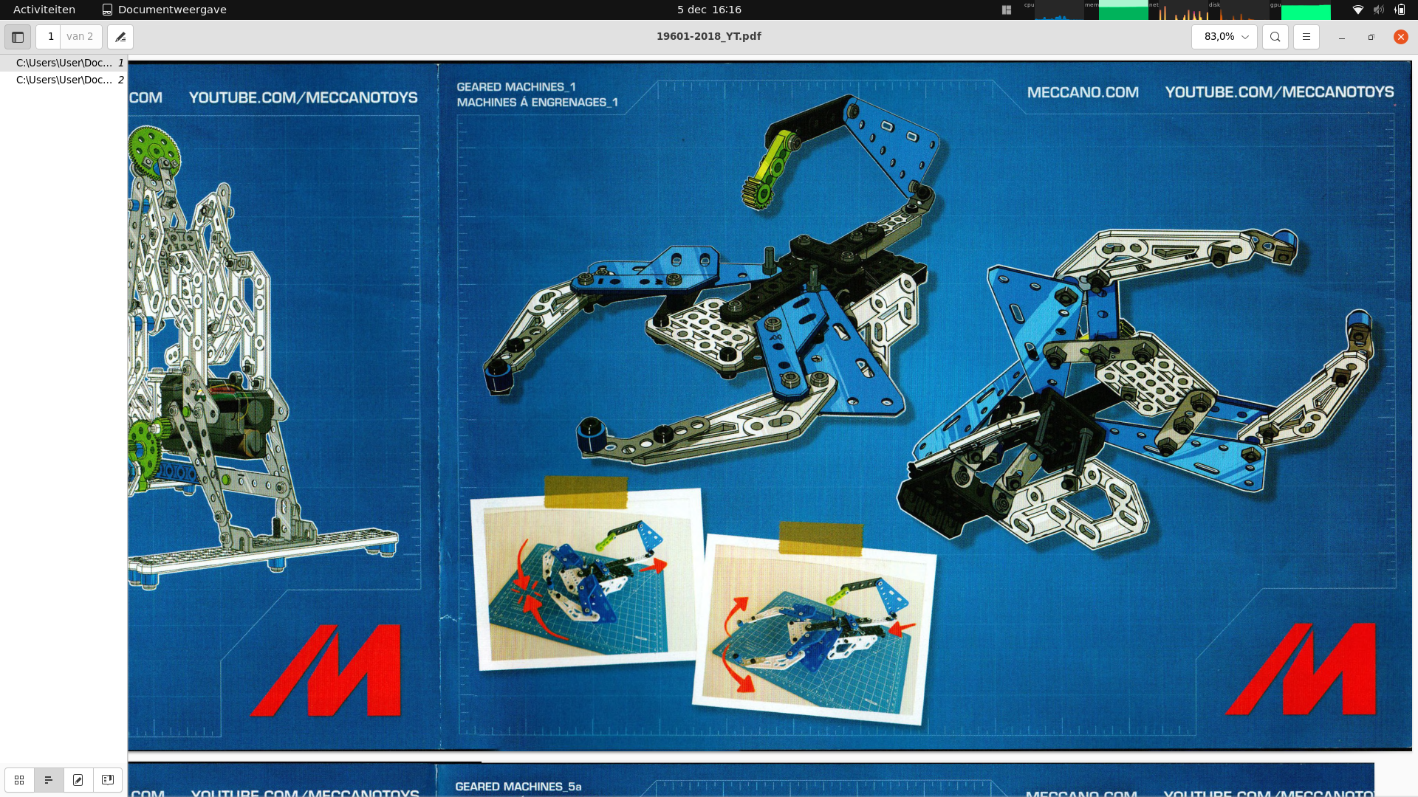
Meccano’s model

Slide 4
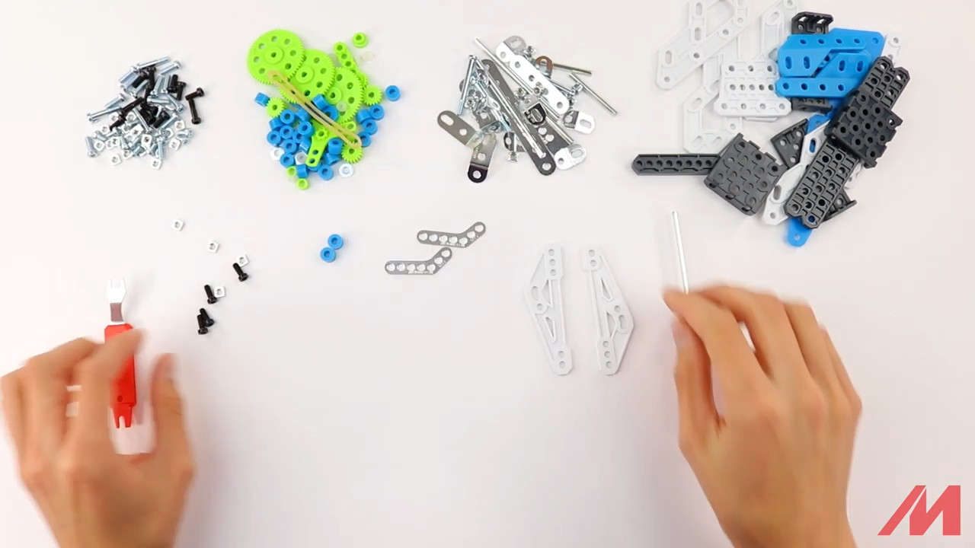
Step 1 – start
2x D018 white plastic triangles
2x C775 metal bended strips
2x A238 blue spacers
4x S2 black bolts
4x A337 nuts

Slide 5
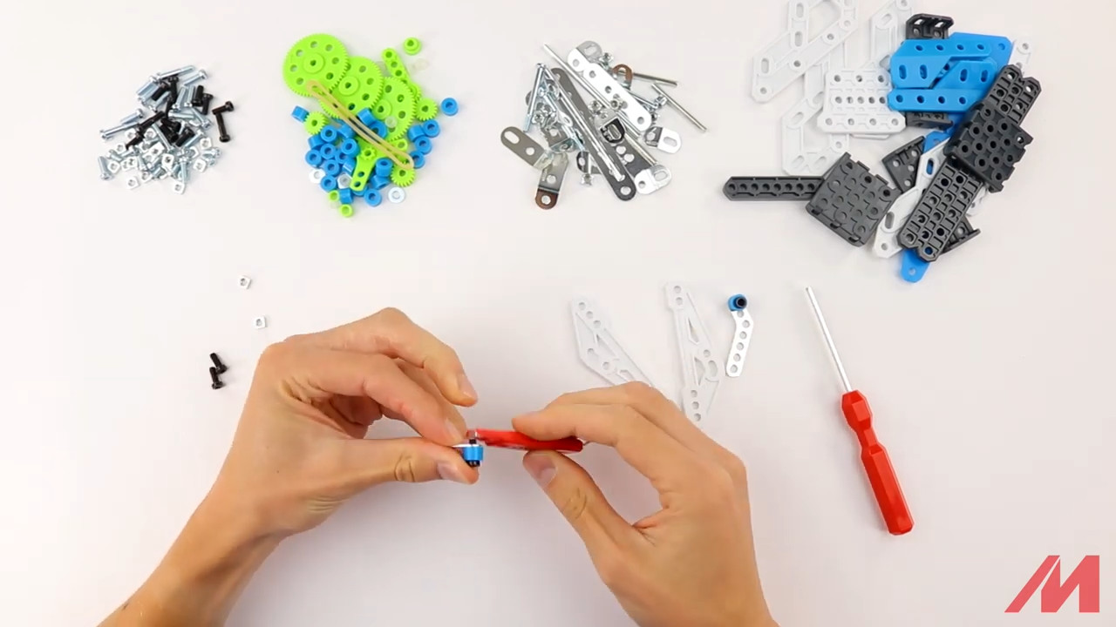
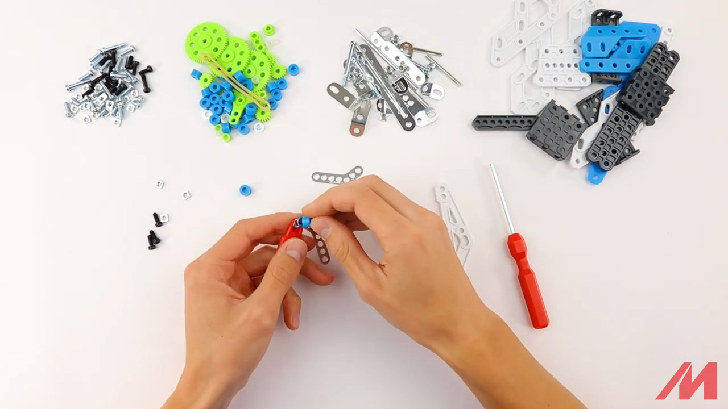
Step 1 x2 mirrored

Slide 6
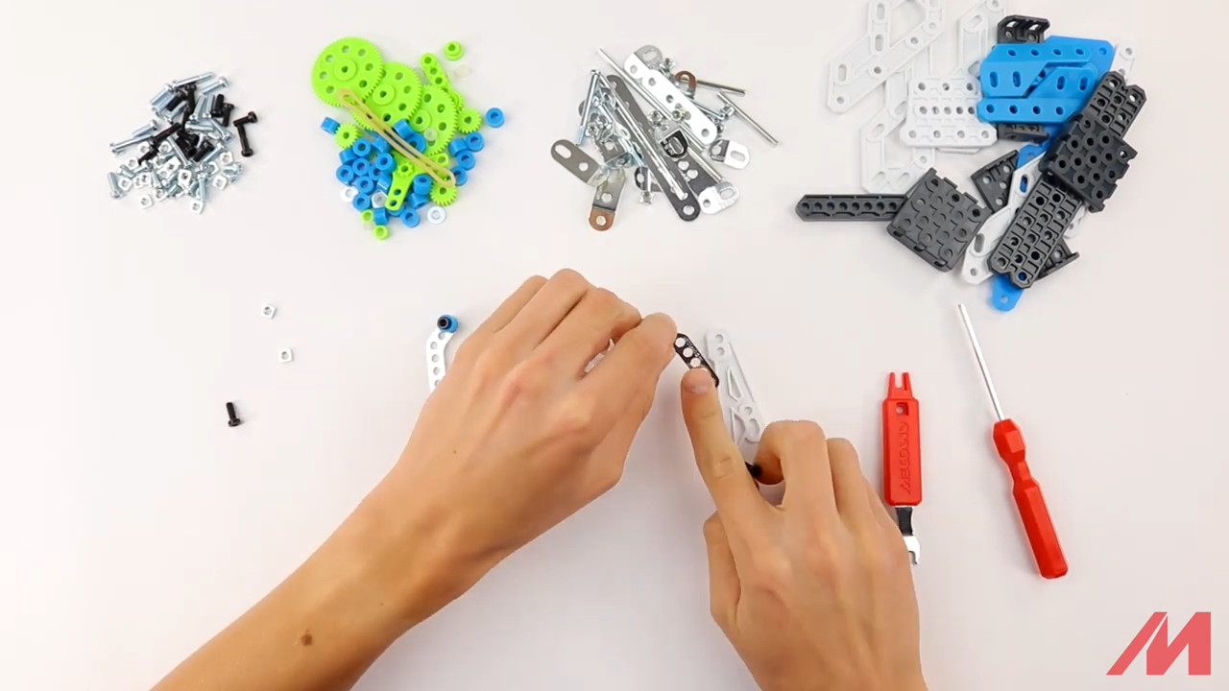
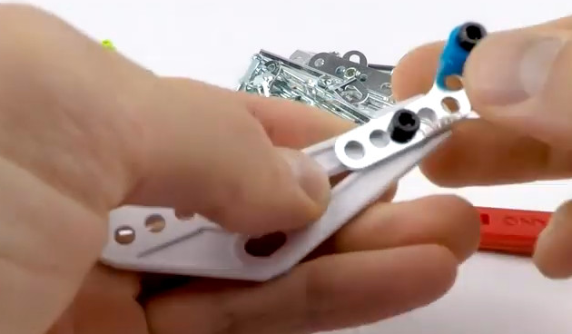
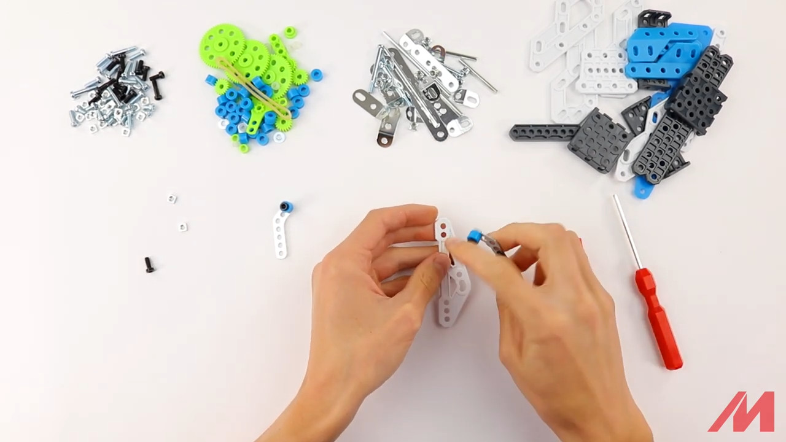
Step 1 – x2

Slide 7
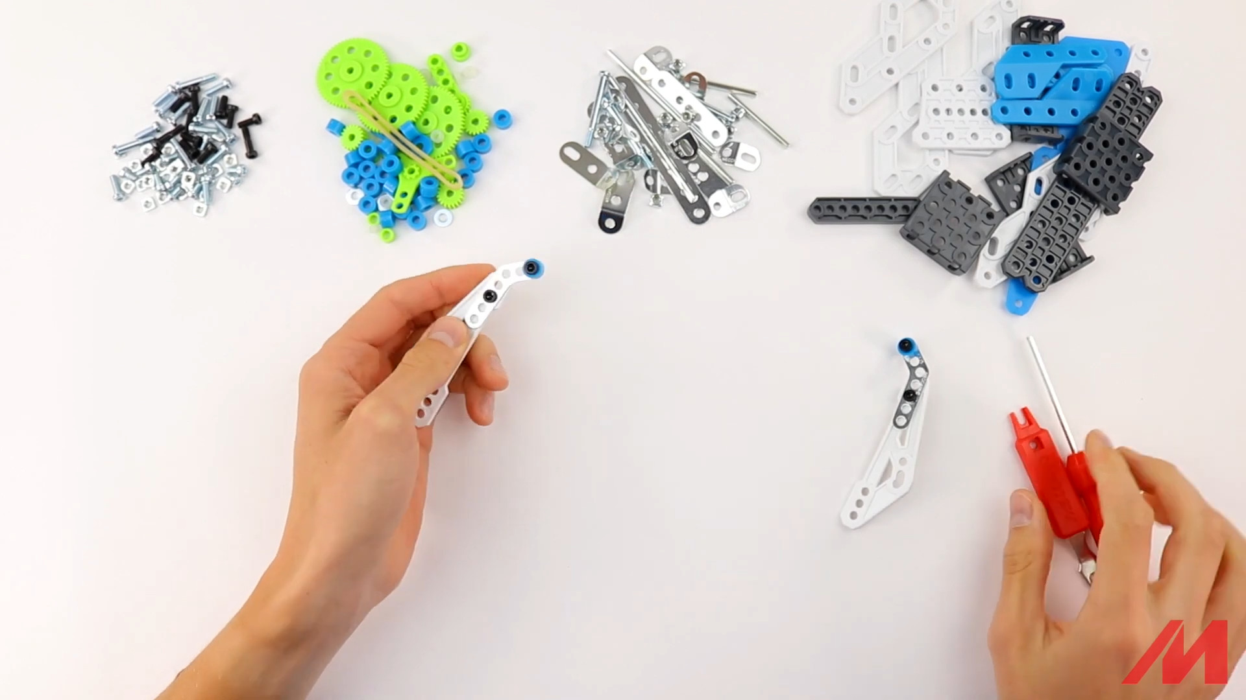
Step 1 – result

Slide 8
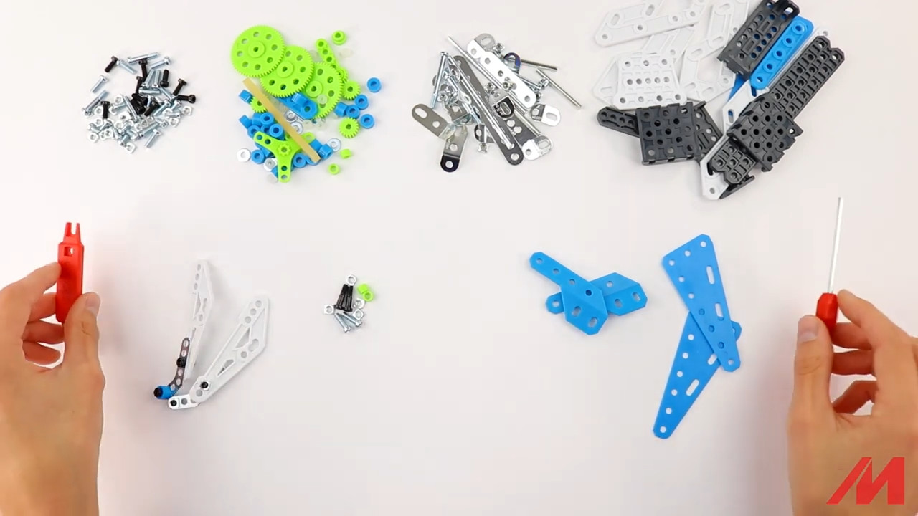
Step 2 – start
2x D121 blue triangles
2x D051/D052 blue plastic pieces
2x green washers
2x B1 black bolt
2x S3 metal bolt
4x A337 nuts

Slide 9
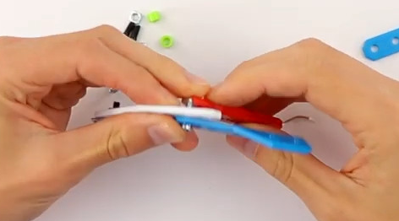
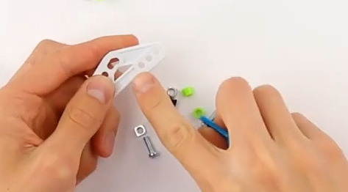
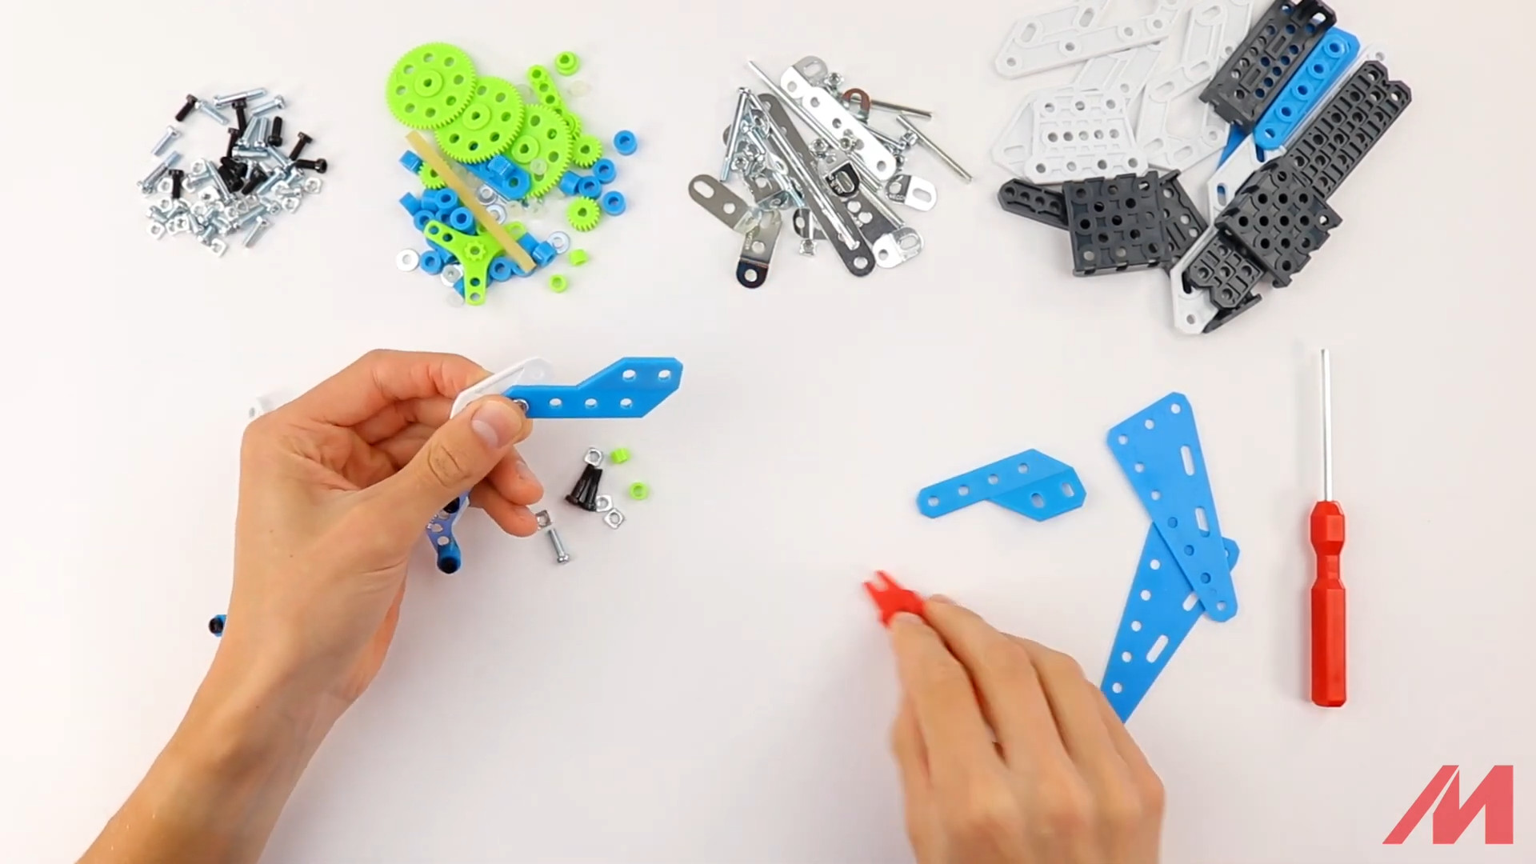
Step 2

Slide 10
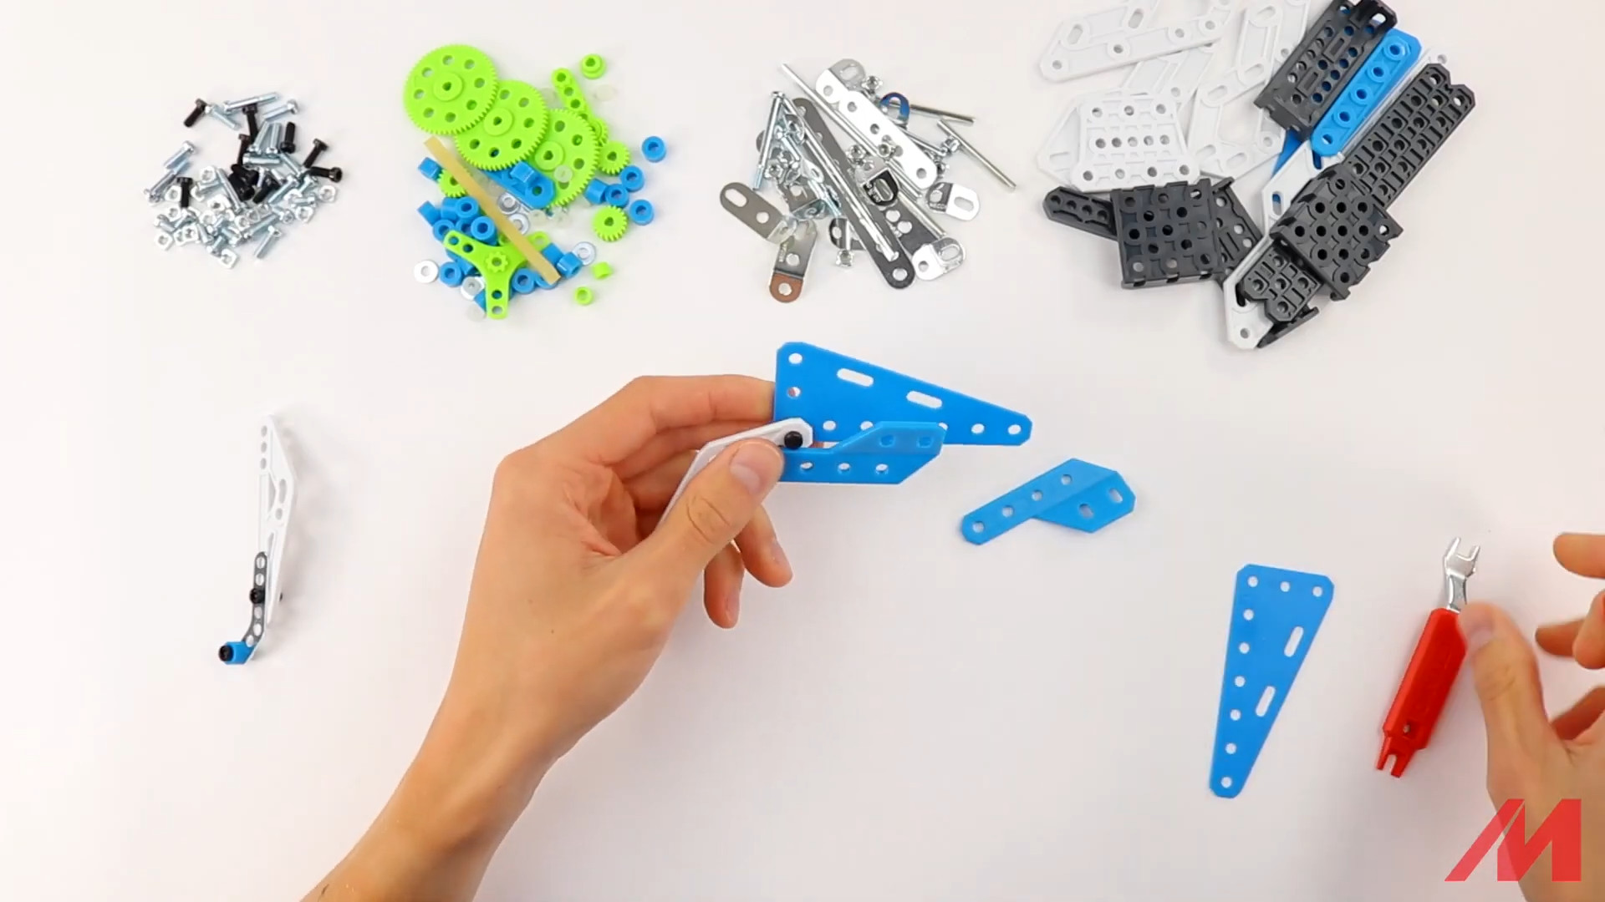
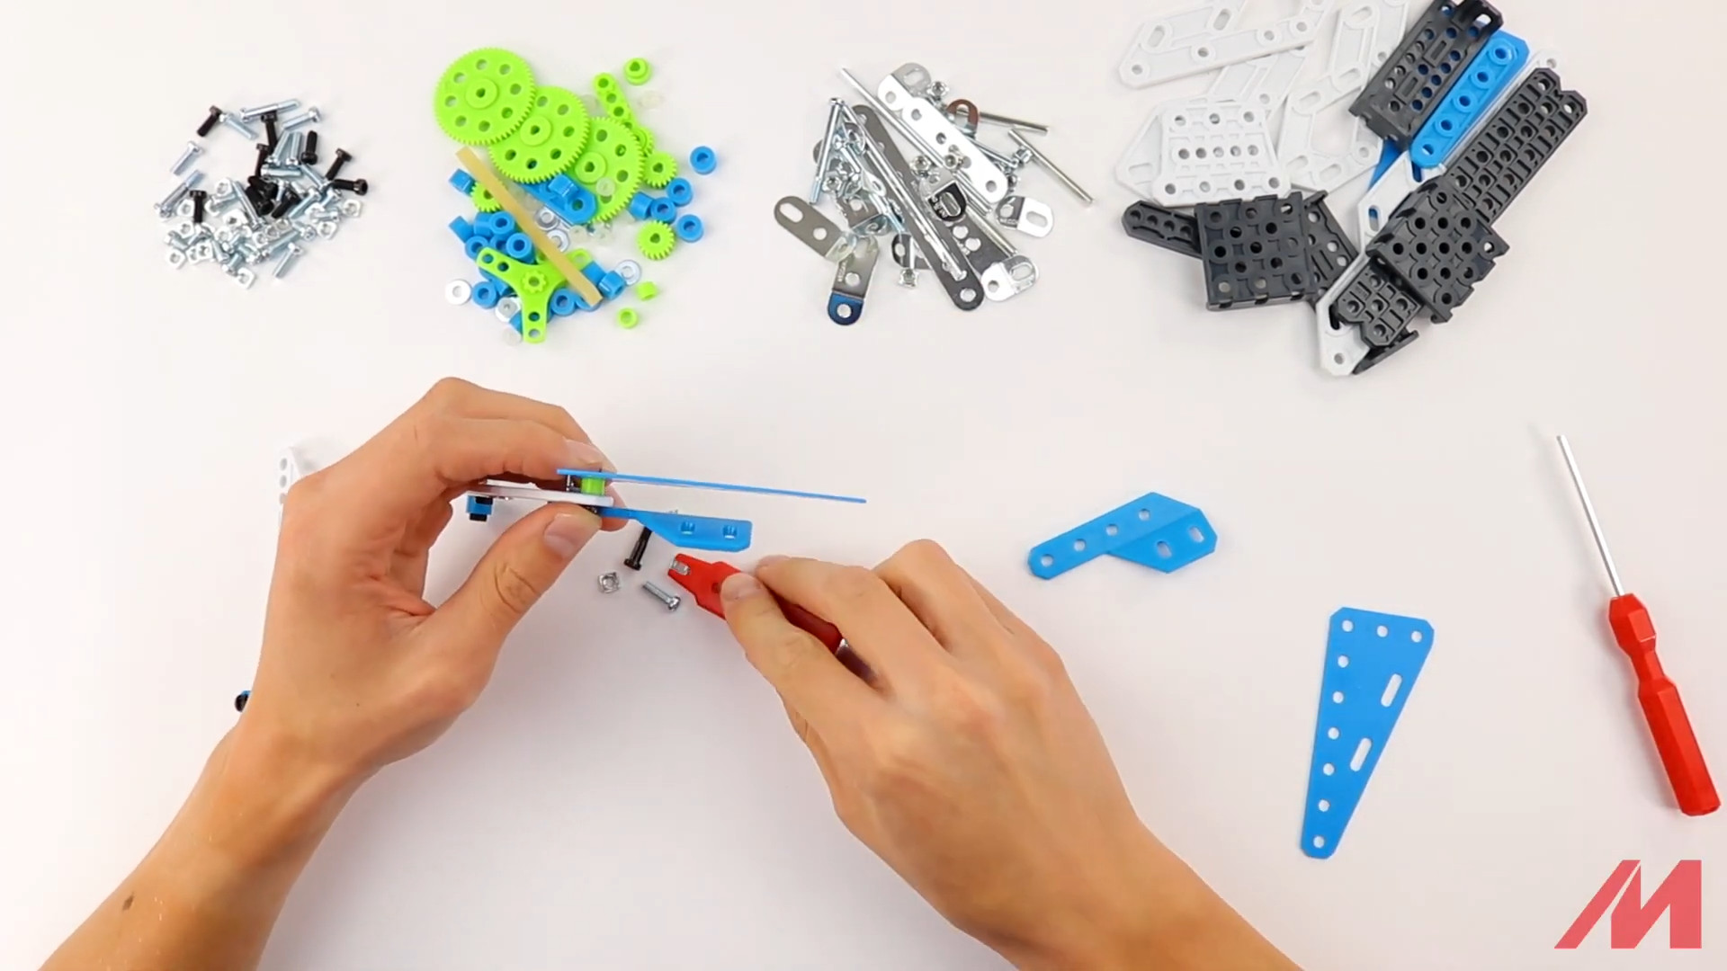
Step 2

Slide 11
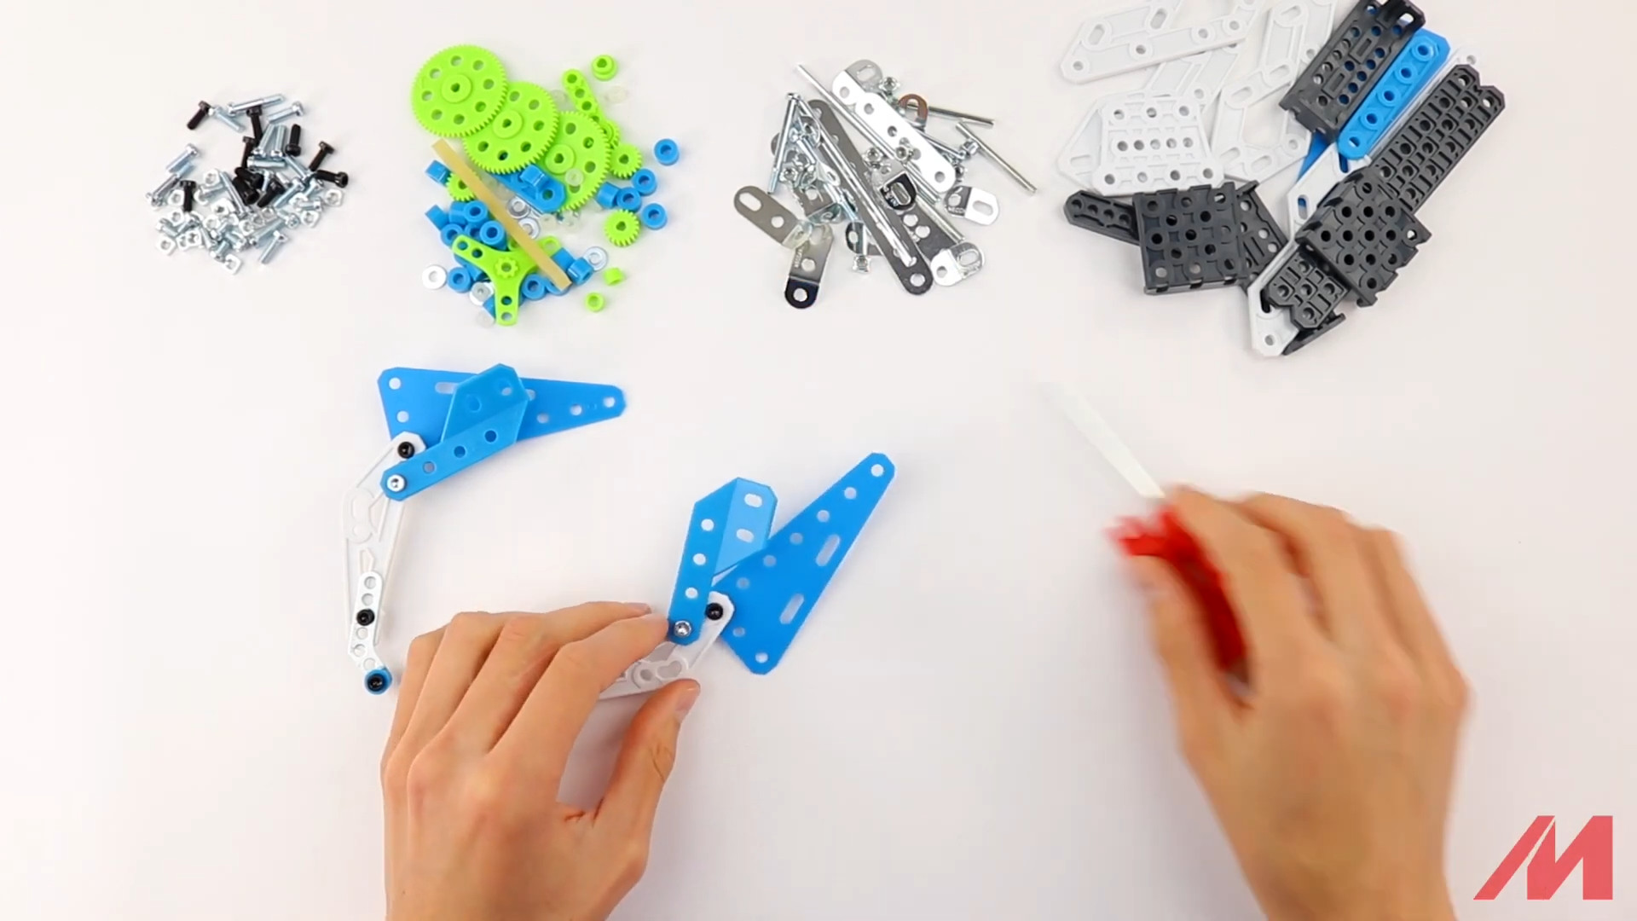
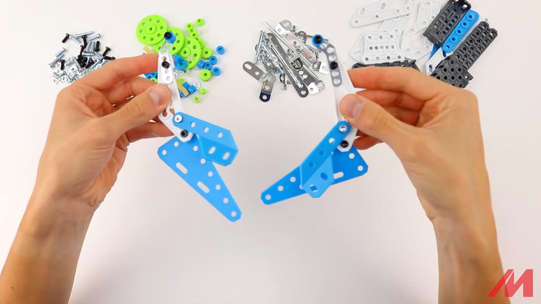
Step 2 – result

Slide 12
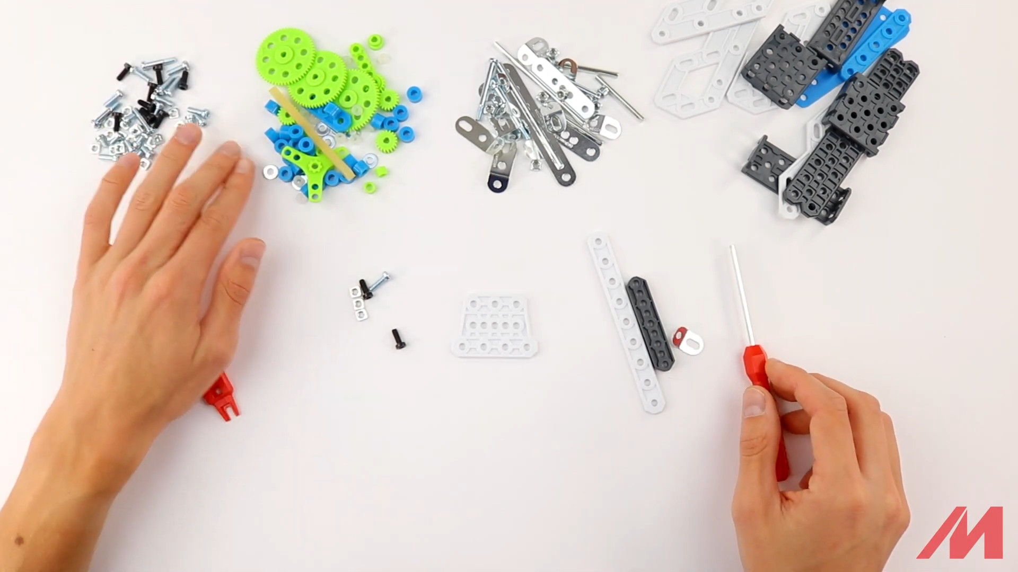
Step 3 – start
1x D143 white plastic strip
1x B051 black plastic profile
1x D472(M230) white plastic platform
1x A712 obtuse plied metal strip
2x S2 black bolt
1x S3 metal bolt
3x A337 nuts

Slide 13
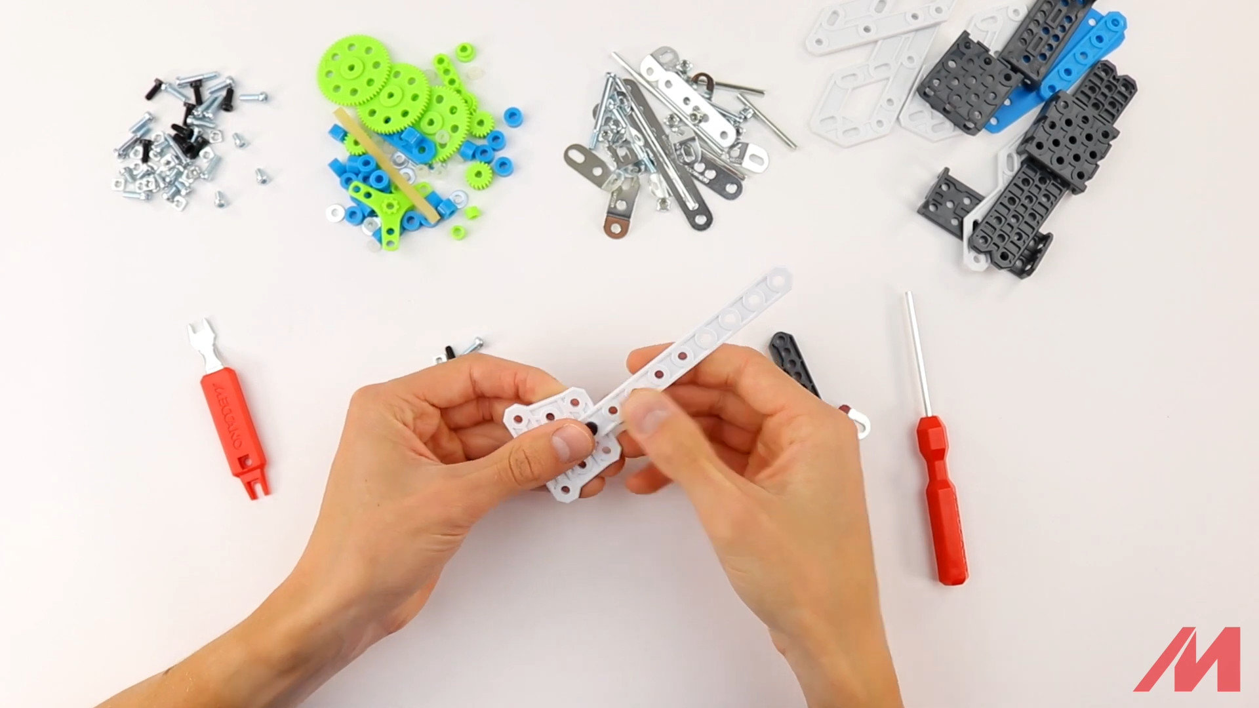
Step 3

Slide 14
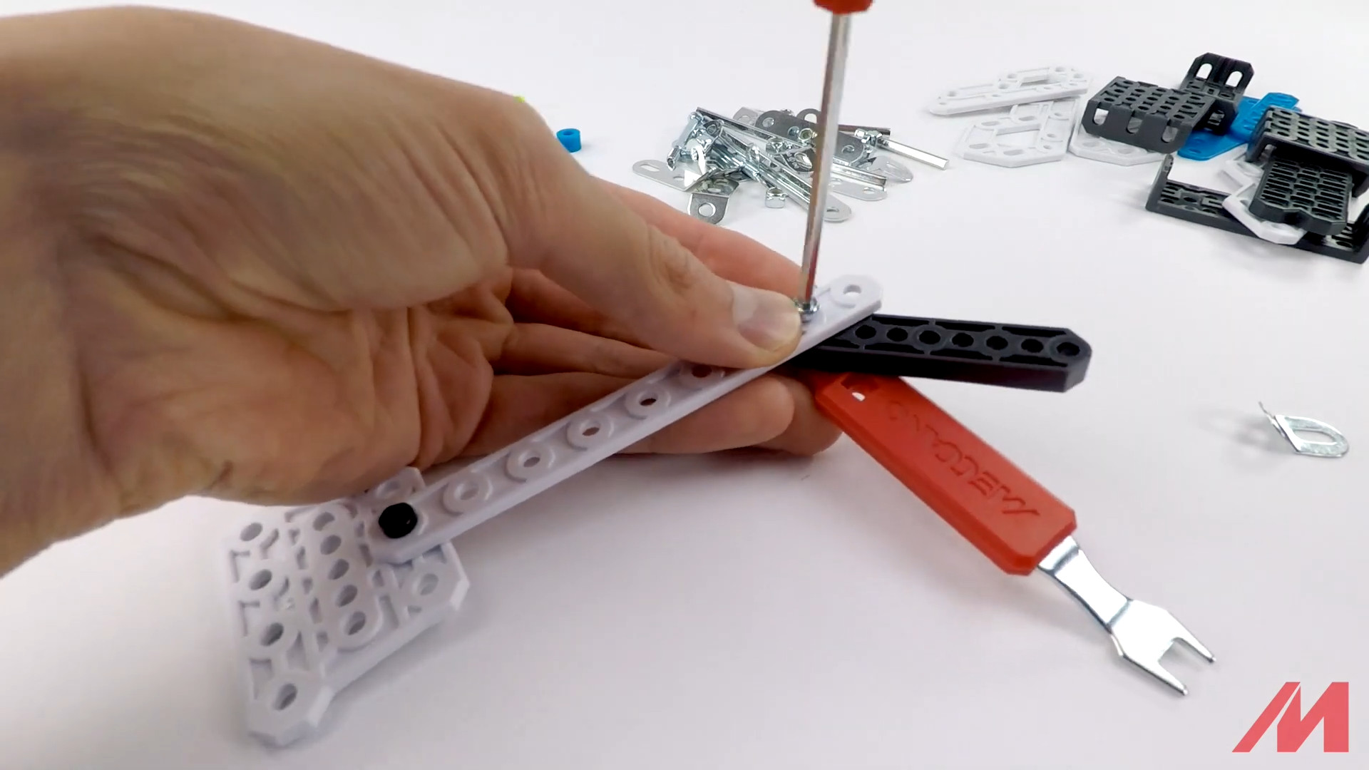
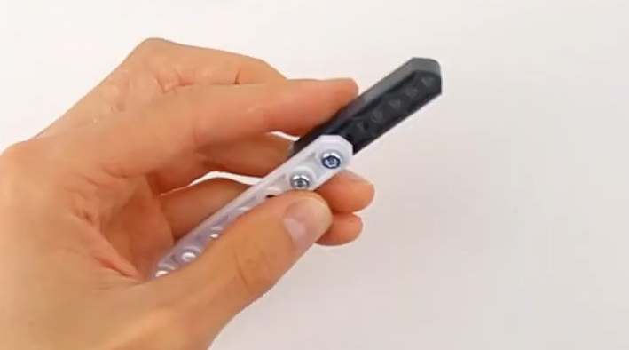
Step 3

Slide 15
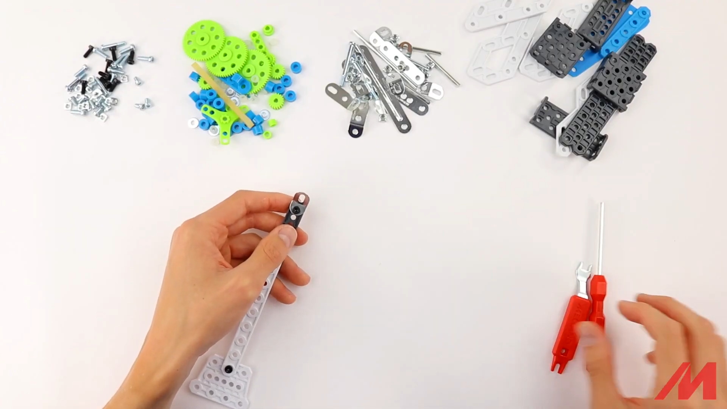
Step 3

Slide 16
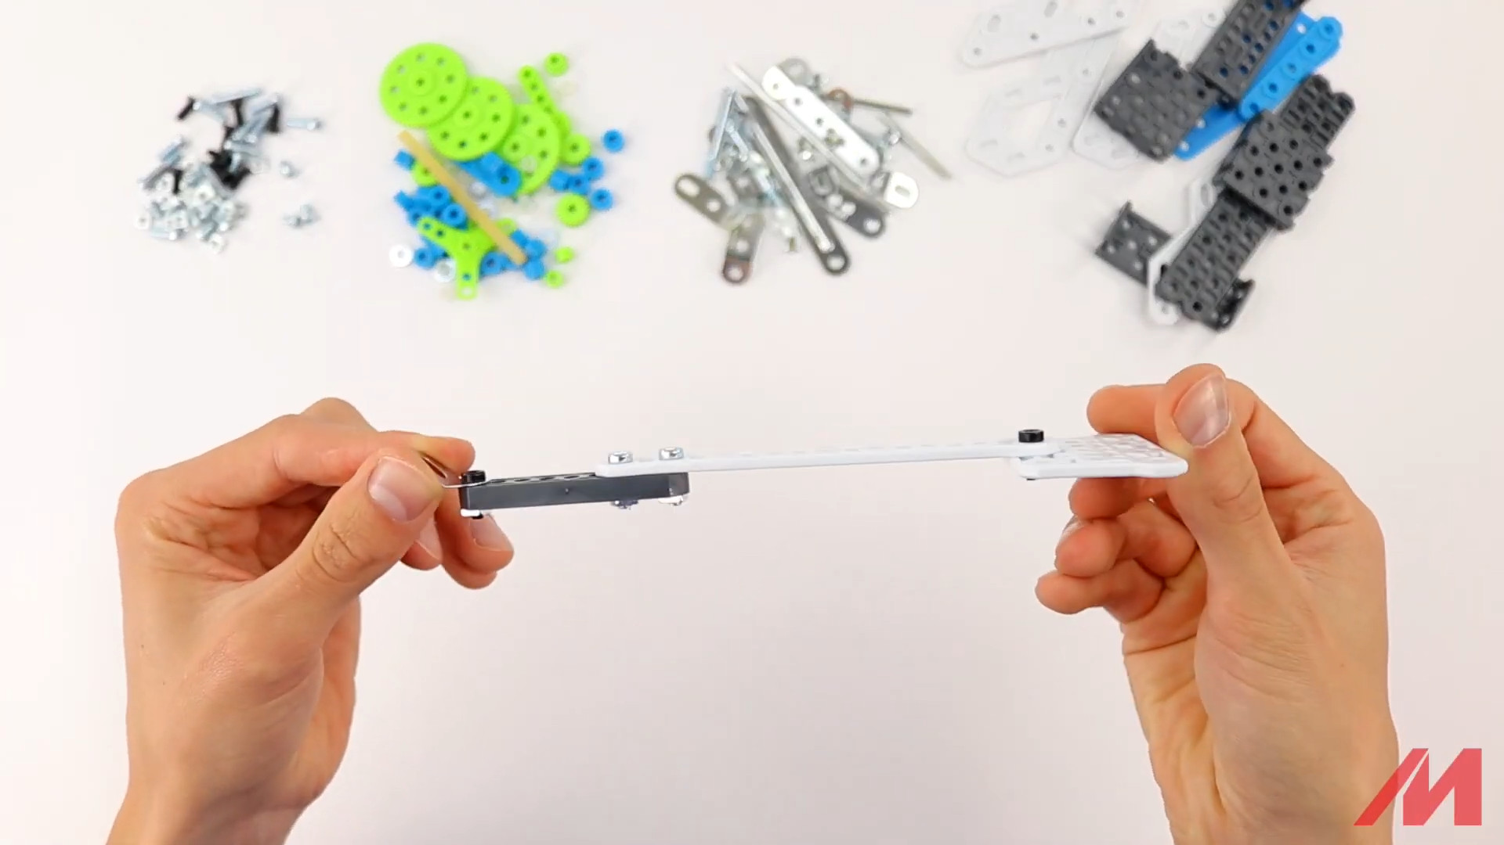
Step 3 – result

Slide 17
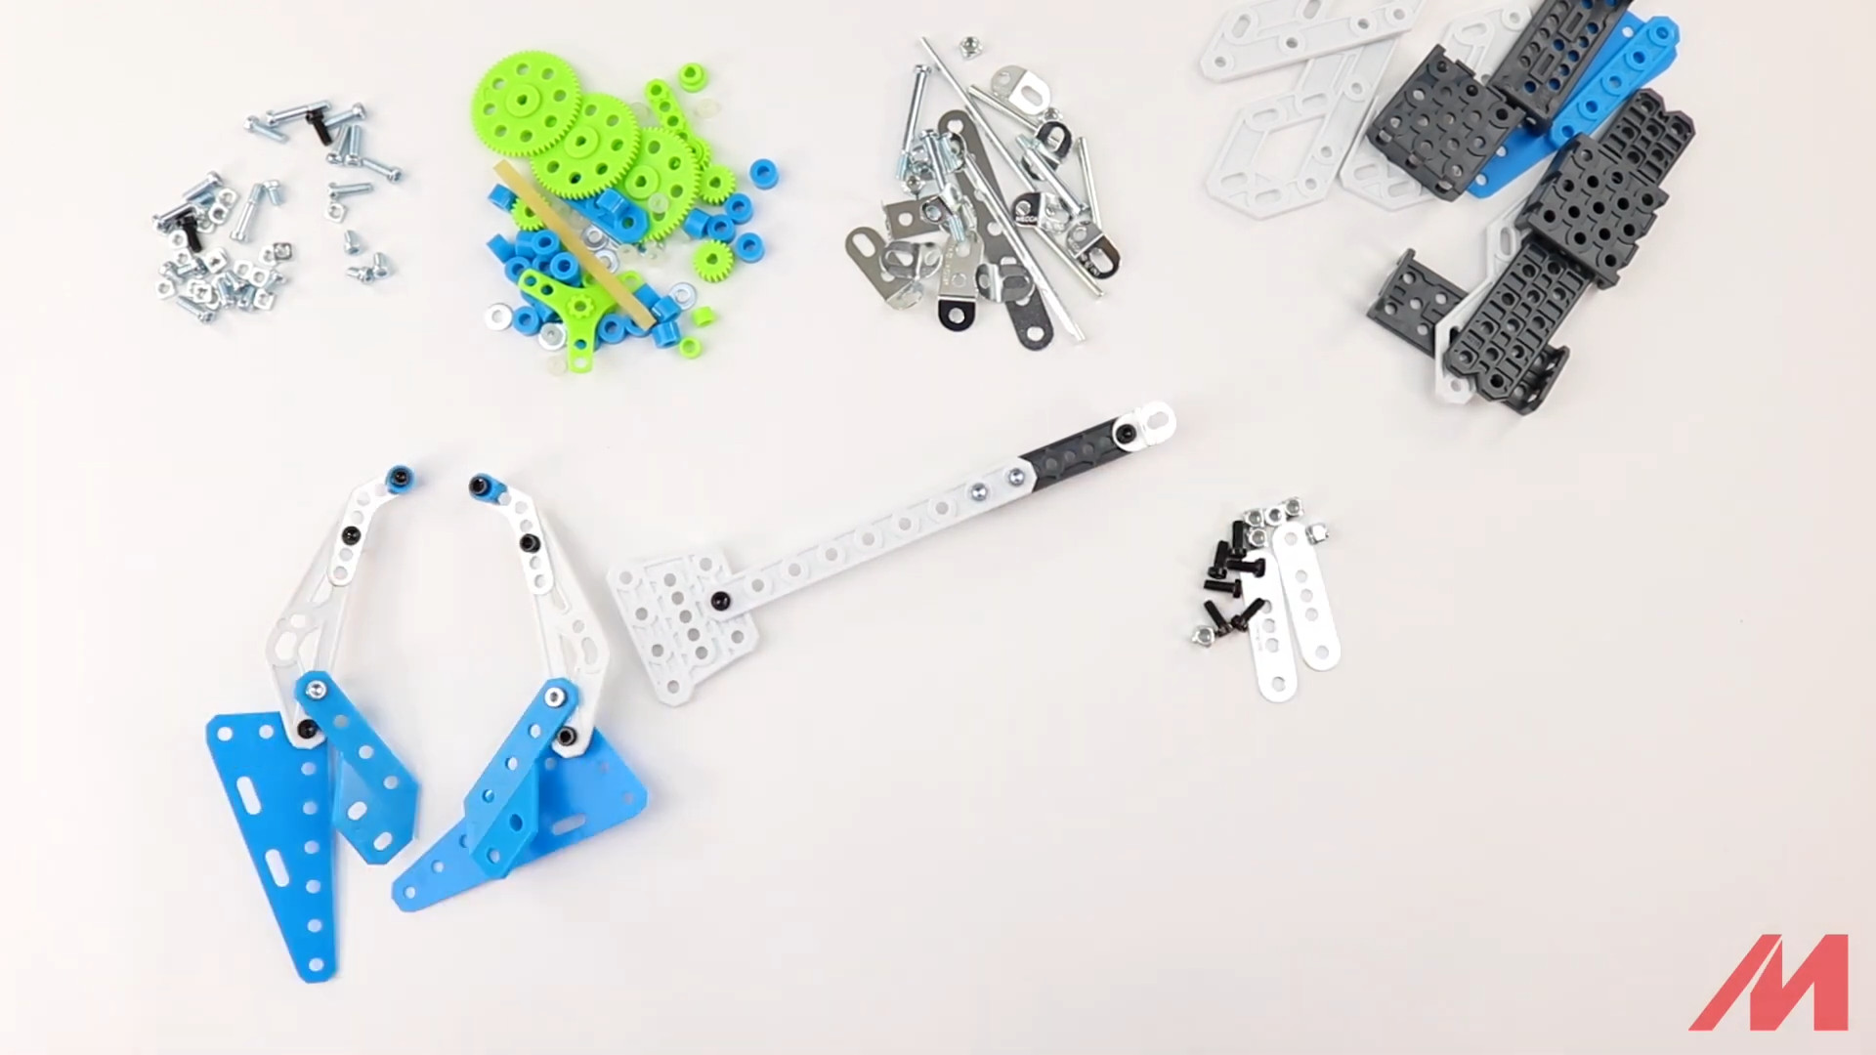
Step 4 – start
2x B146 metal strips
4x S2 black bolts
6x A337 nuts
Don’t hesitate to ask for help! This step is the hardest in this model!

Slide 18
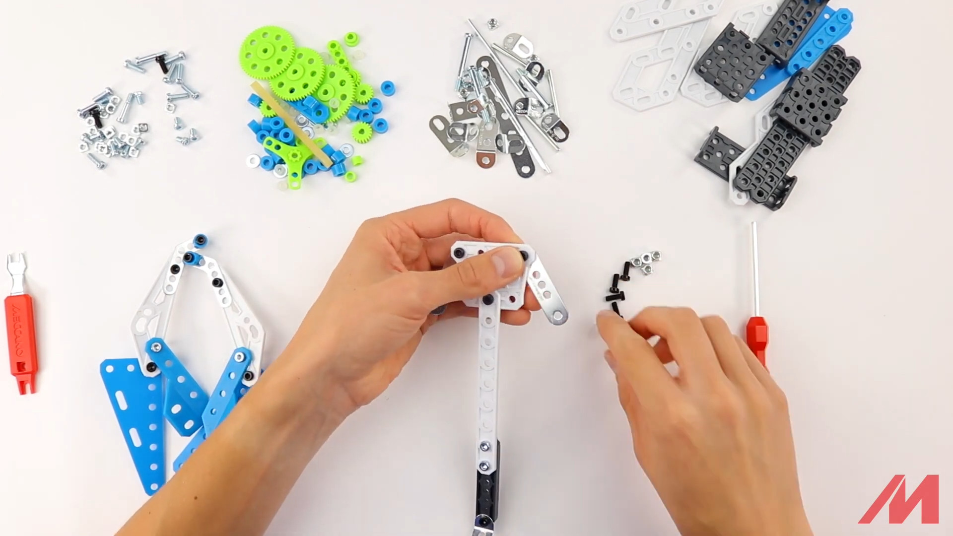
Step 4

Slide 19
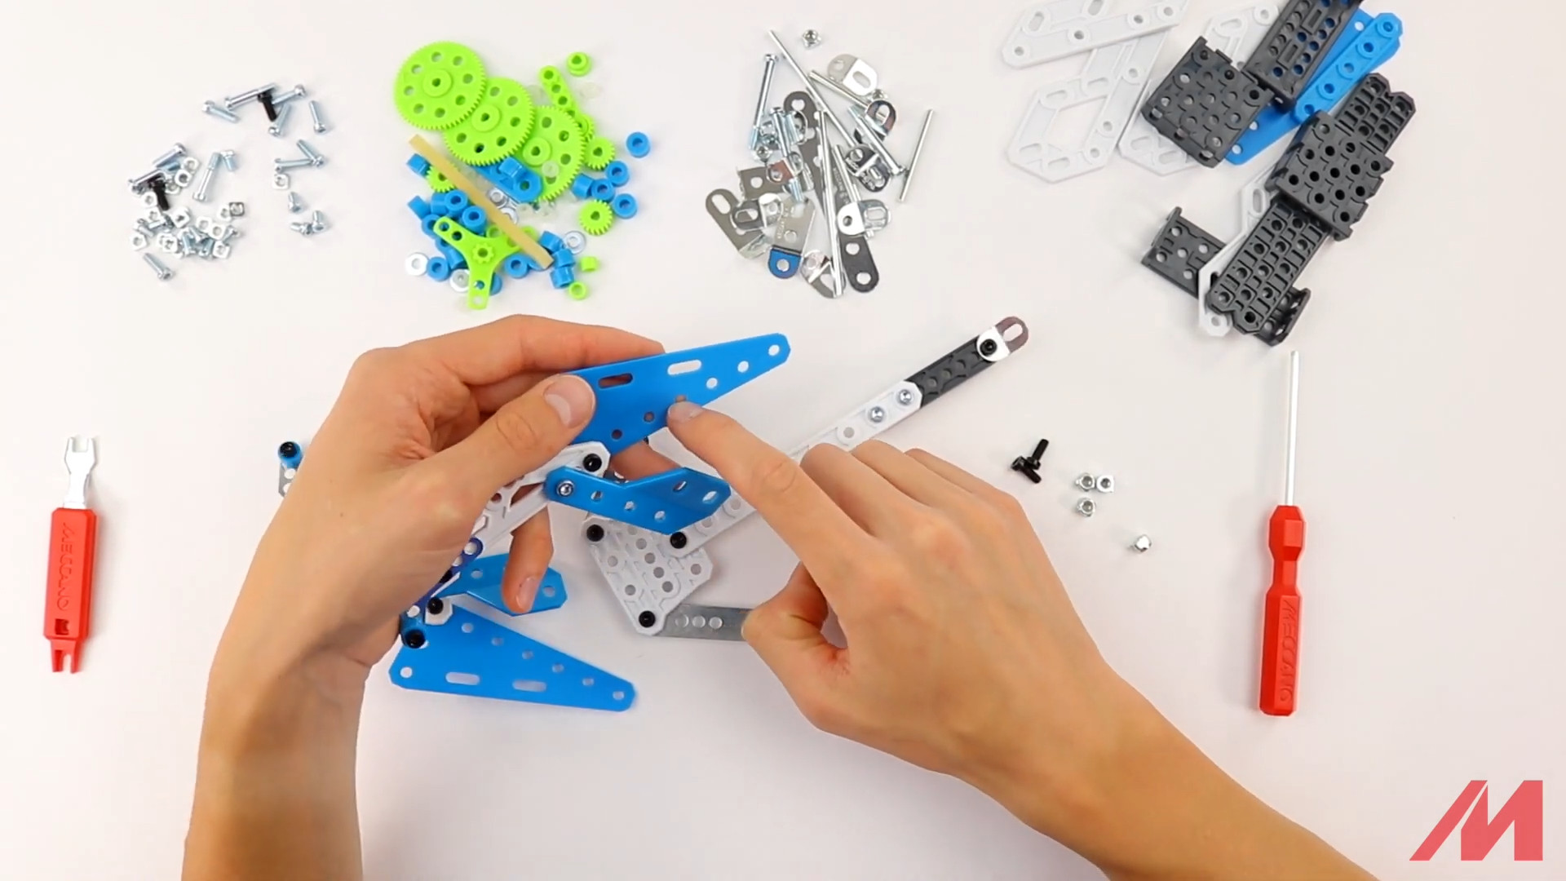
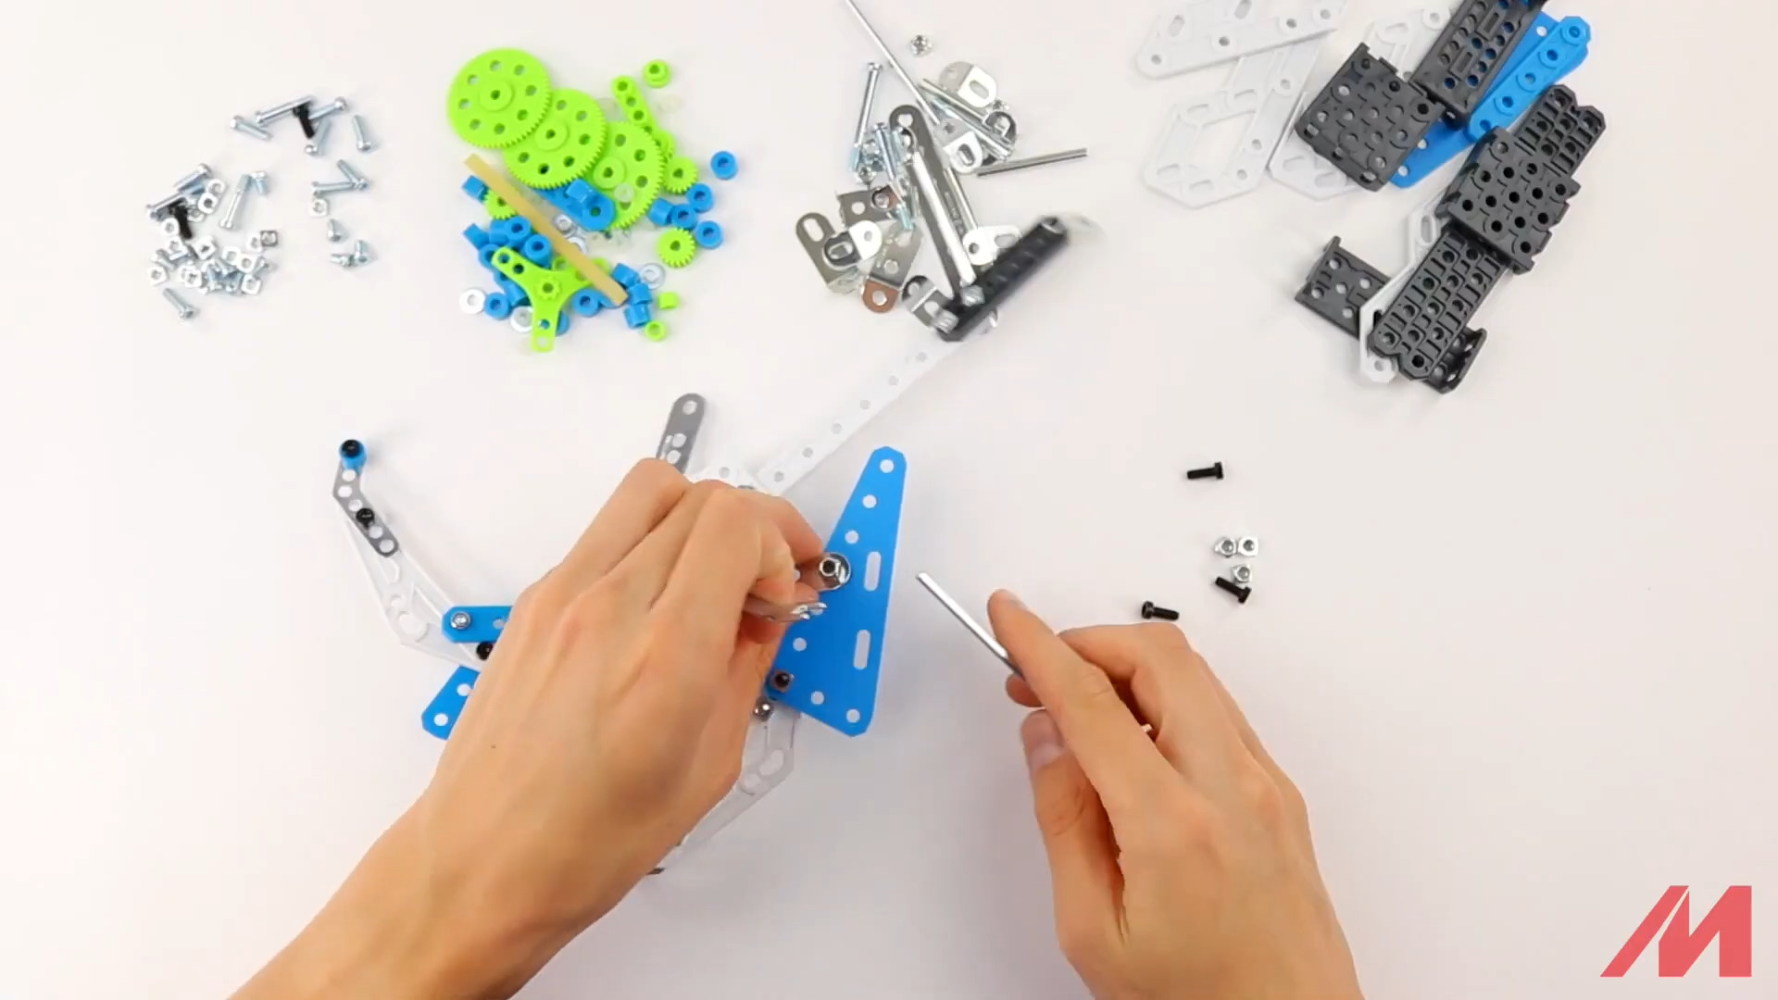
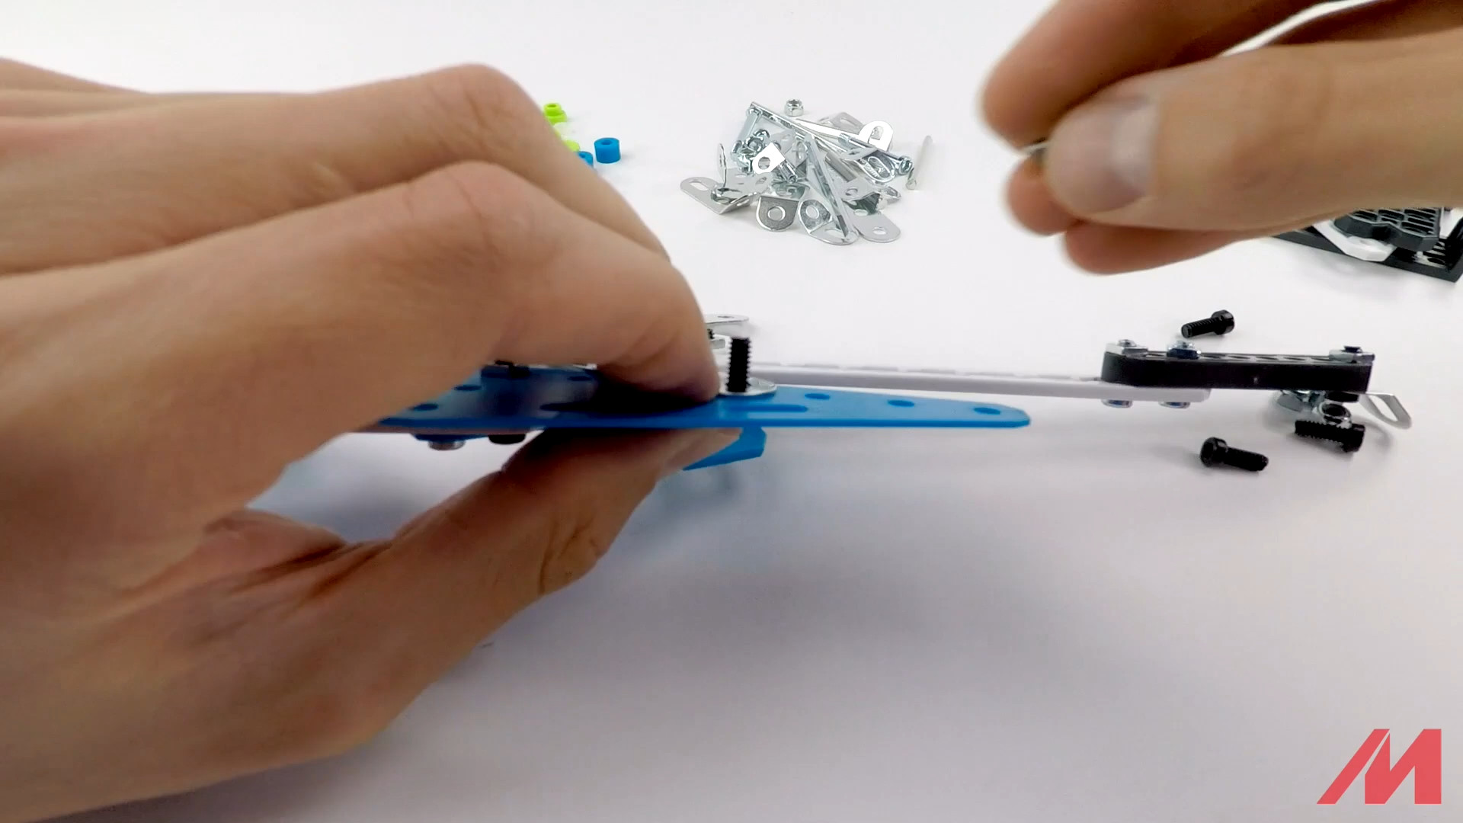
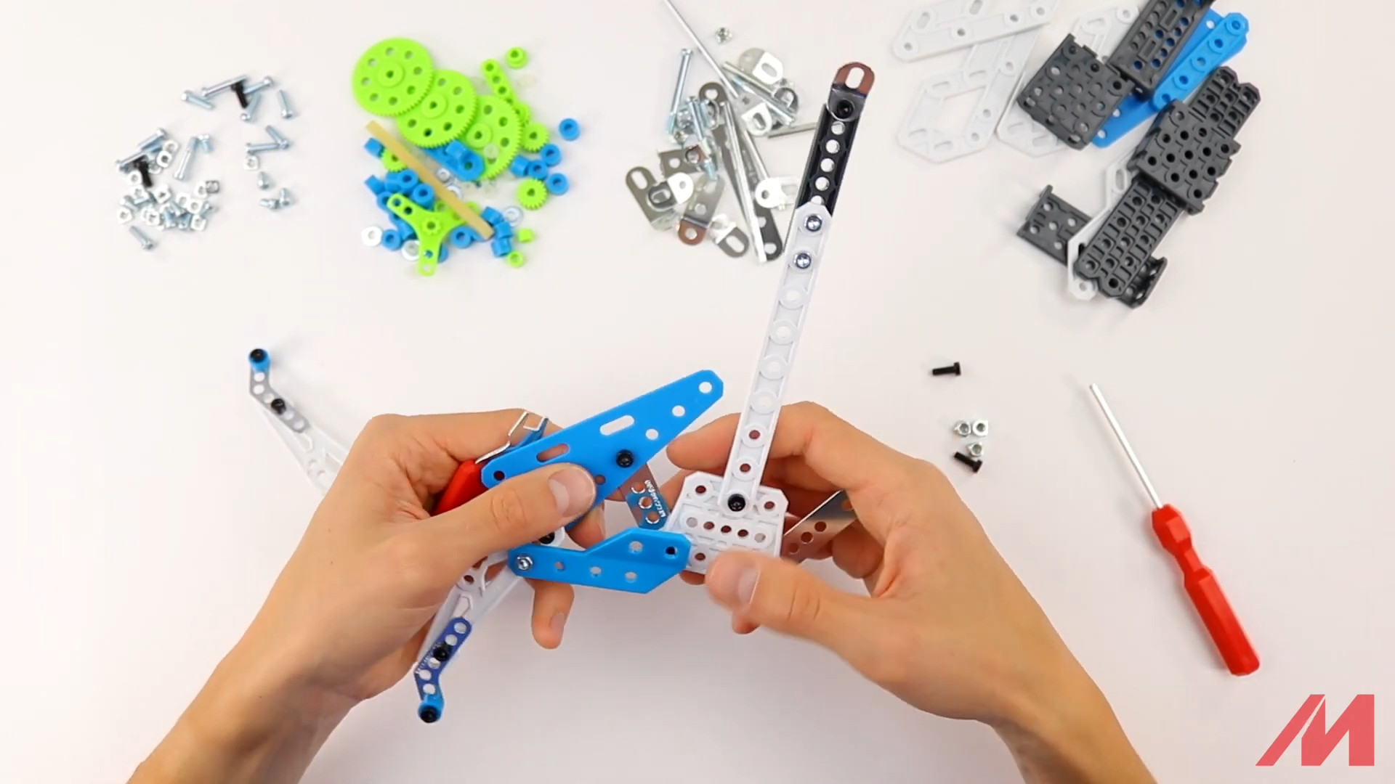
Step 4

Slide 20
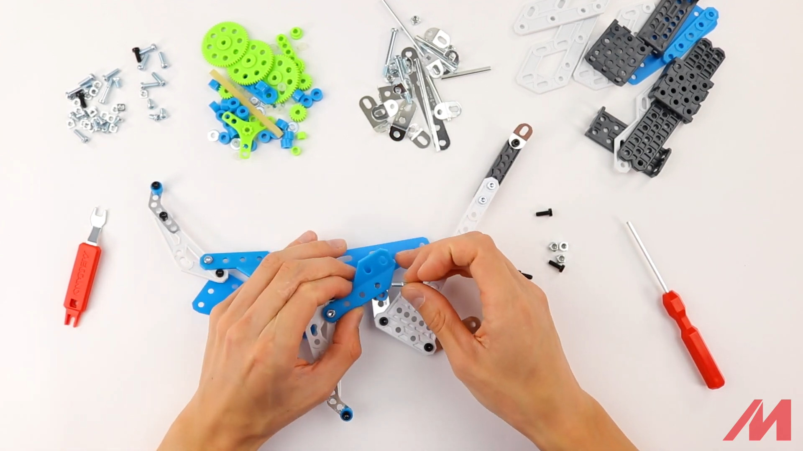
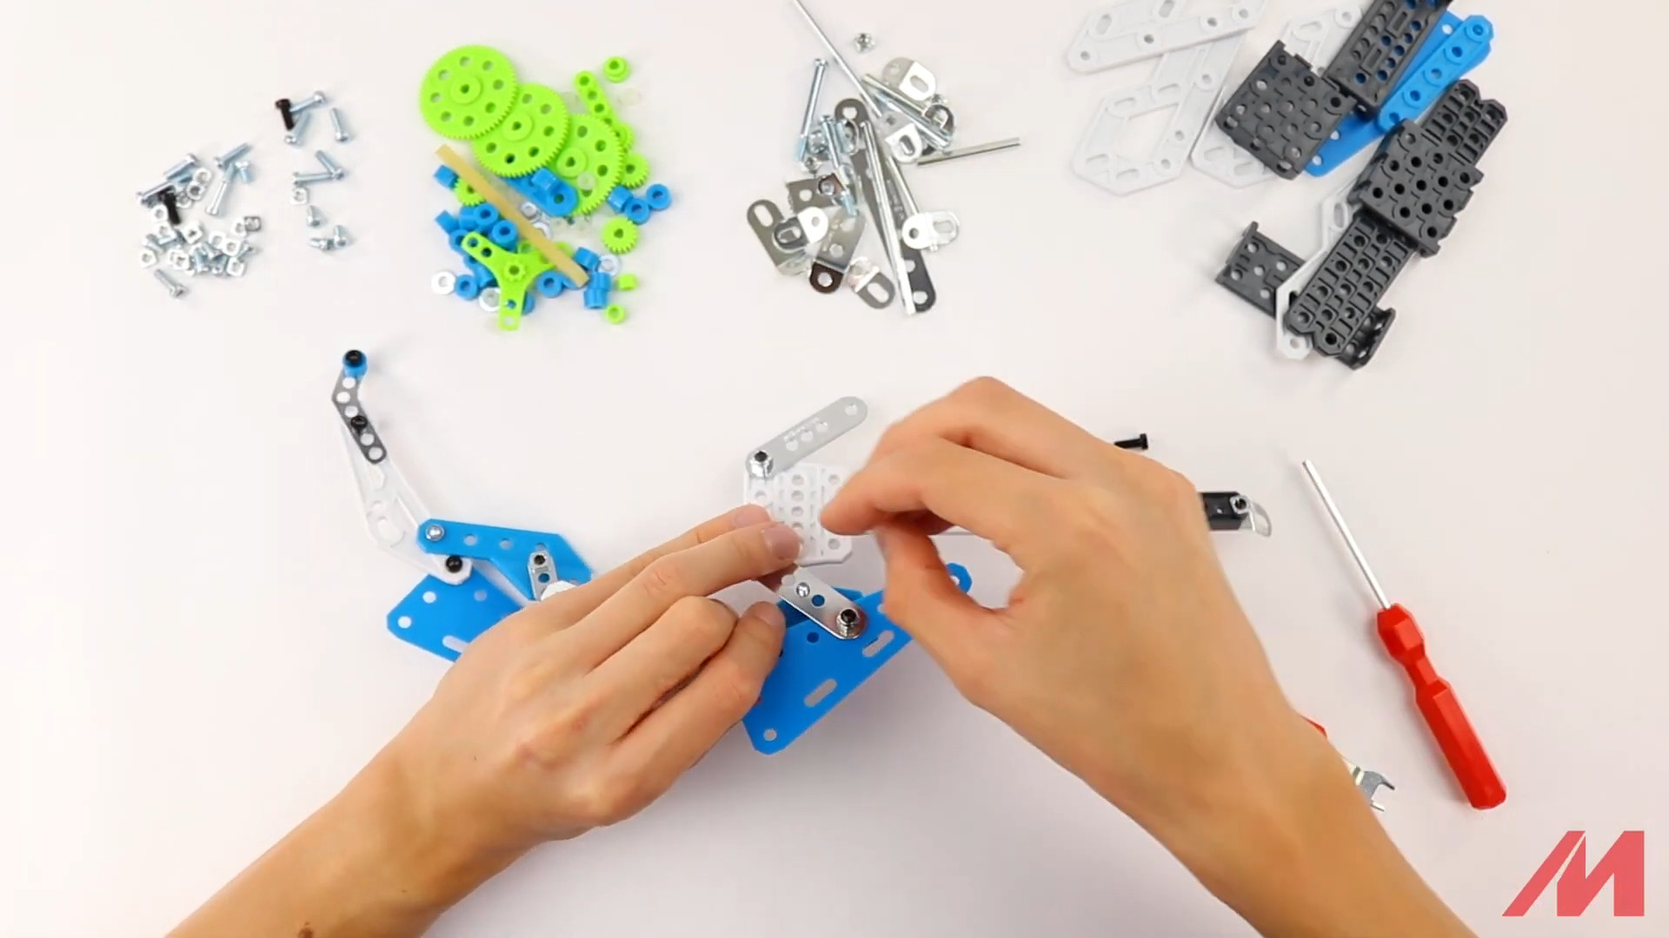
Step 4
Add a blue spacer with a metal bolt S3.
These were not in the start overview of this step!

Slide 21
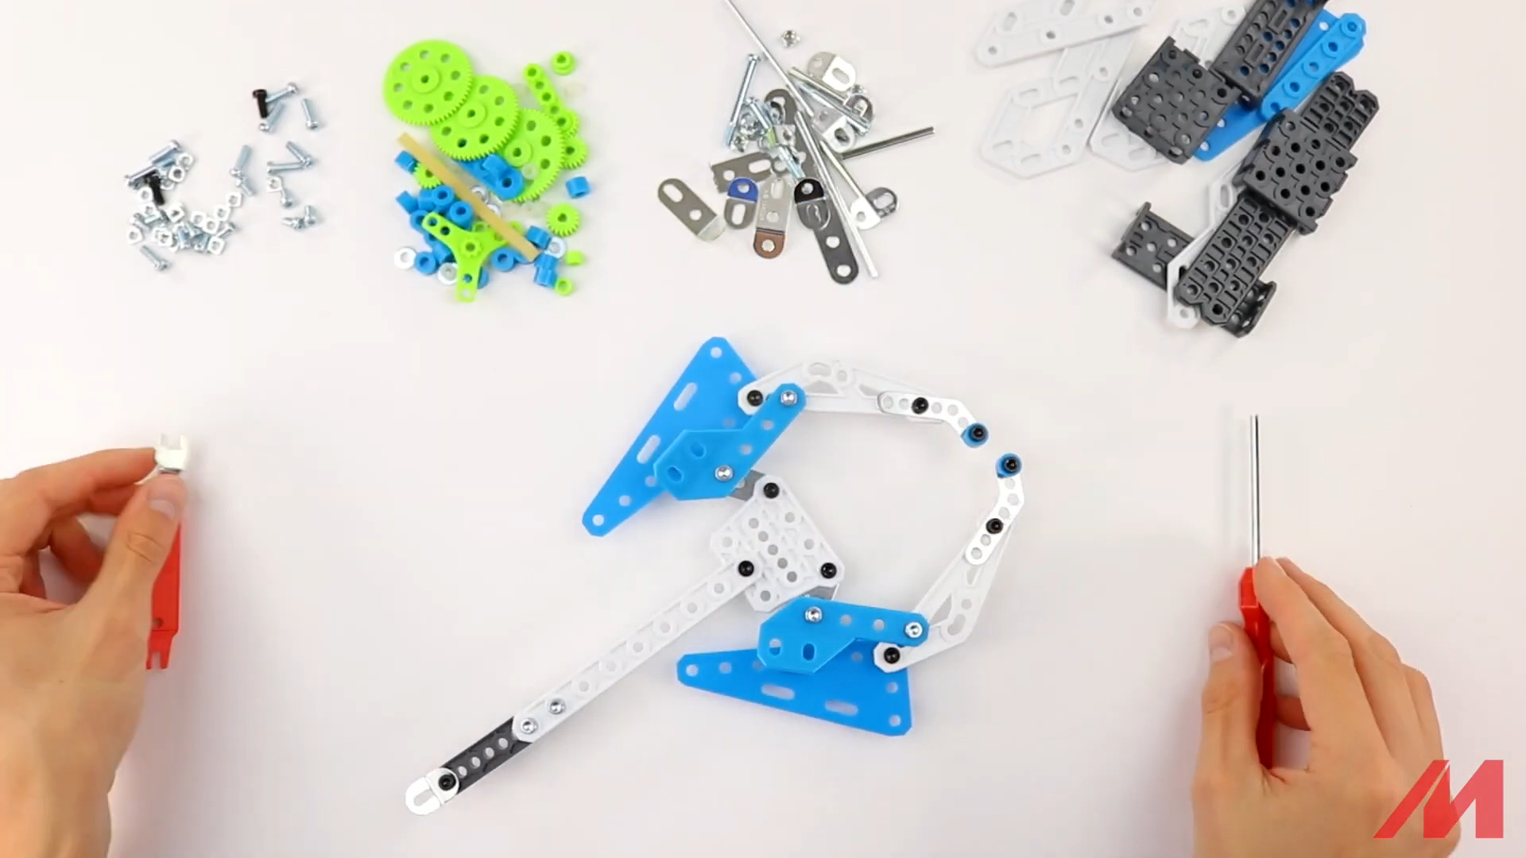
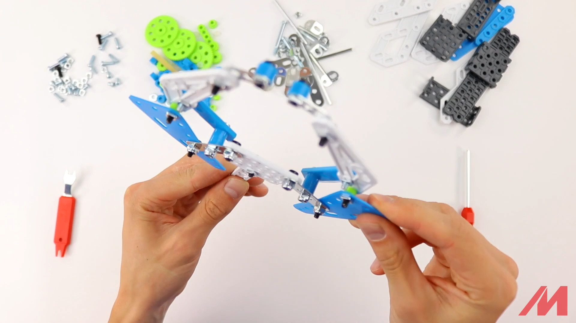
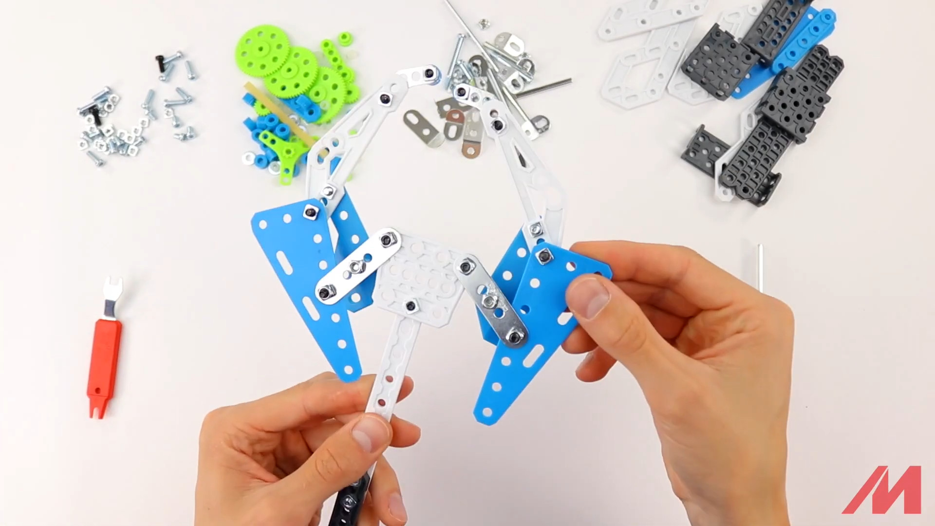
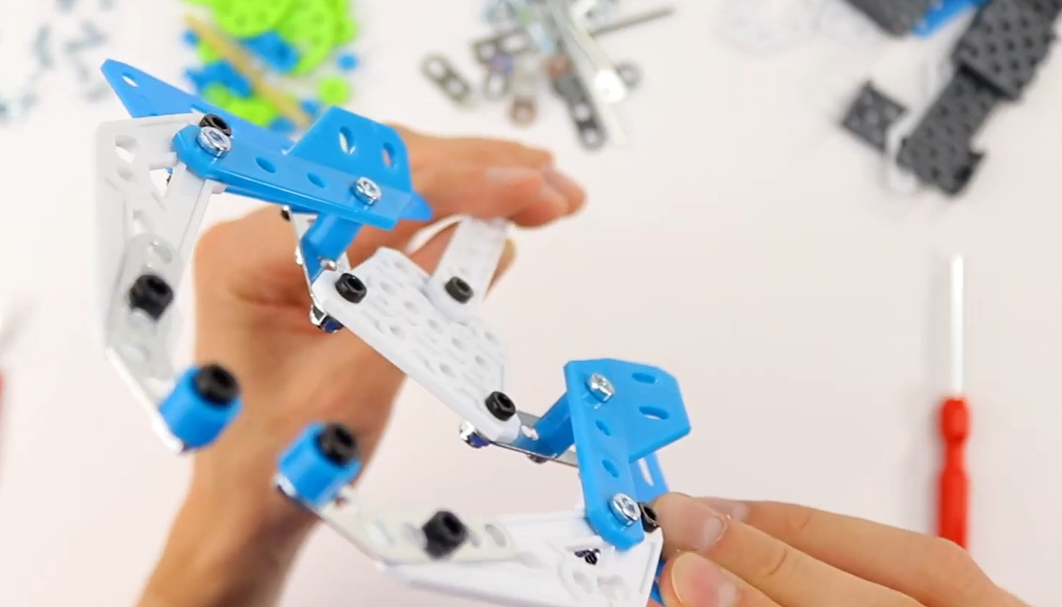
Step 4 – result

Slide 22
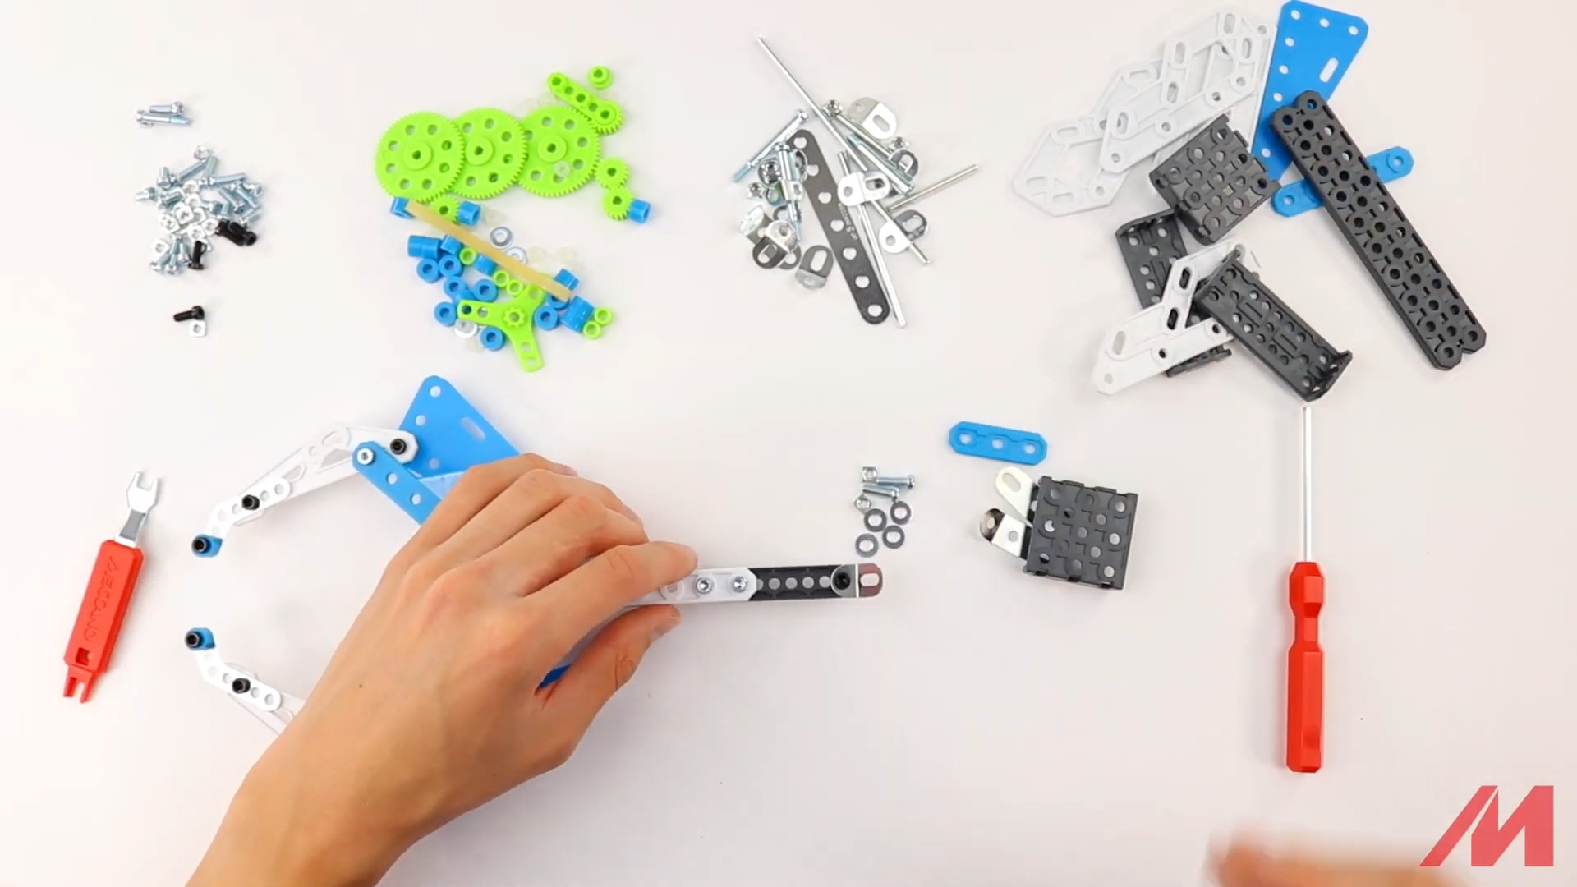
Step 5 – start
1x D049 blue plastic strip
1x D485 black platform
4x A138 metal washers
2x A713 obtuse plied metal strip; 3 holes
2x S3 metal bolts
2x A337 nuts

Slide 23
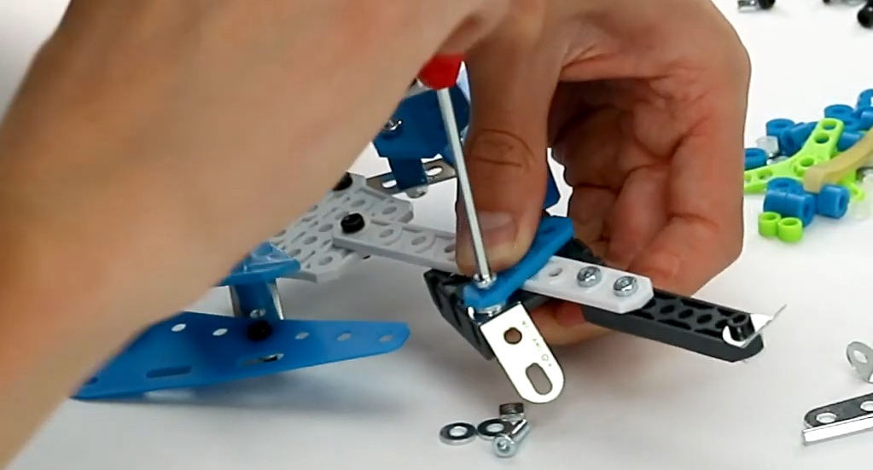
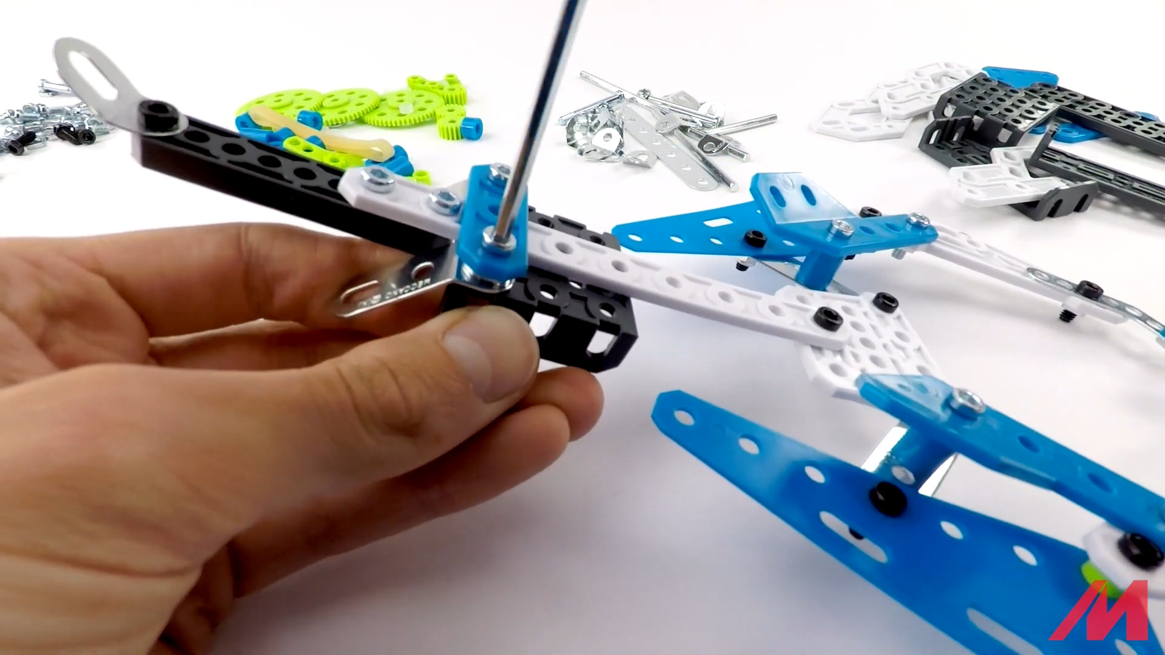
Step 5
2 washers!

Slide 24
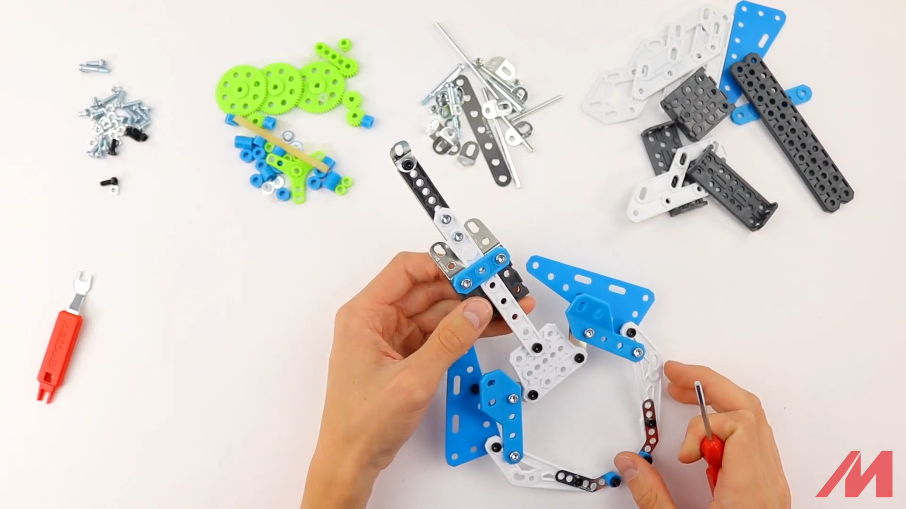
Step 6 – result – should slide!

Slide 25
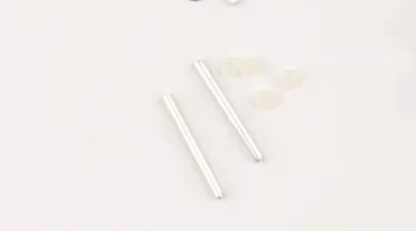
Step 7 – start
2x A429 metal axle
4x A259 rubber washers

Slide 26
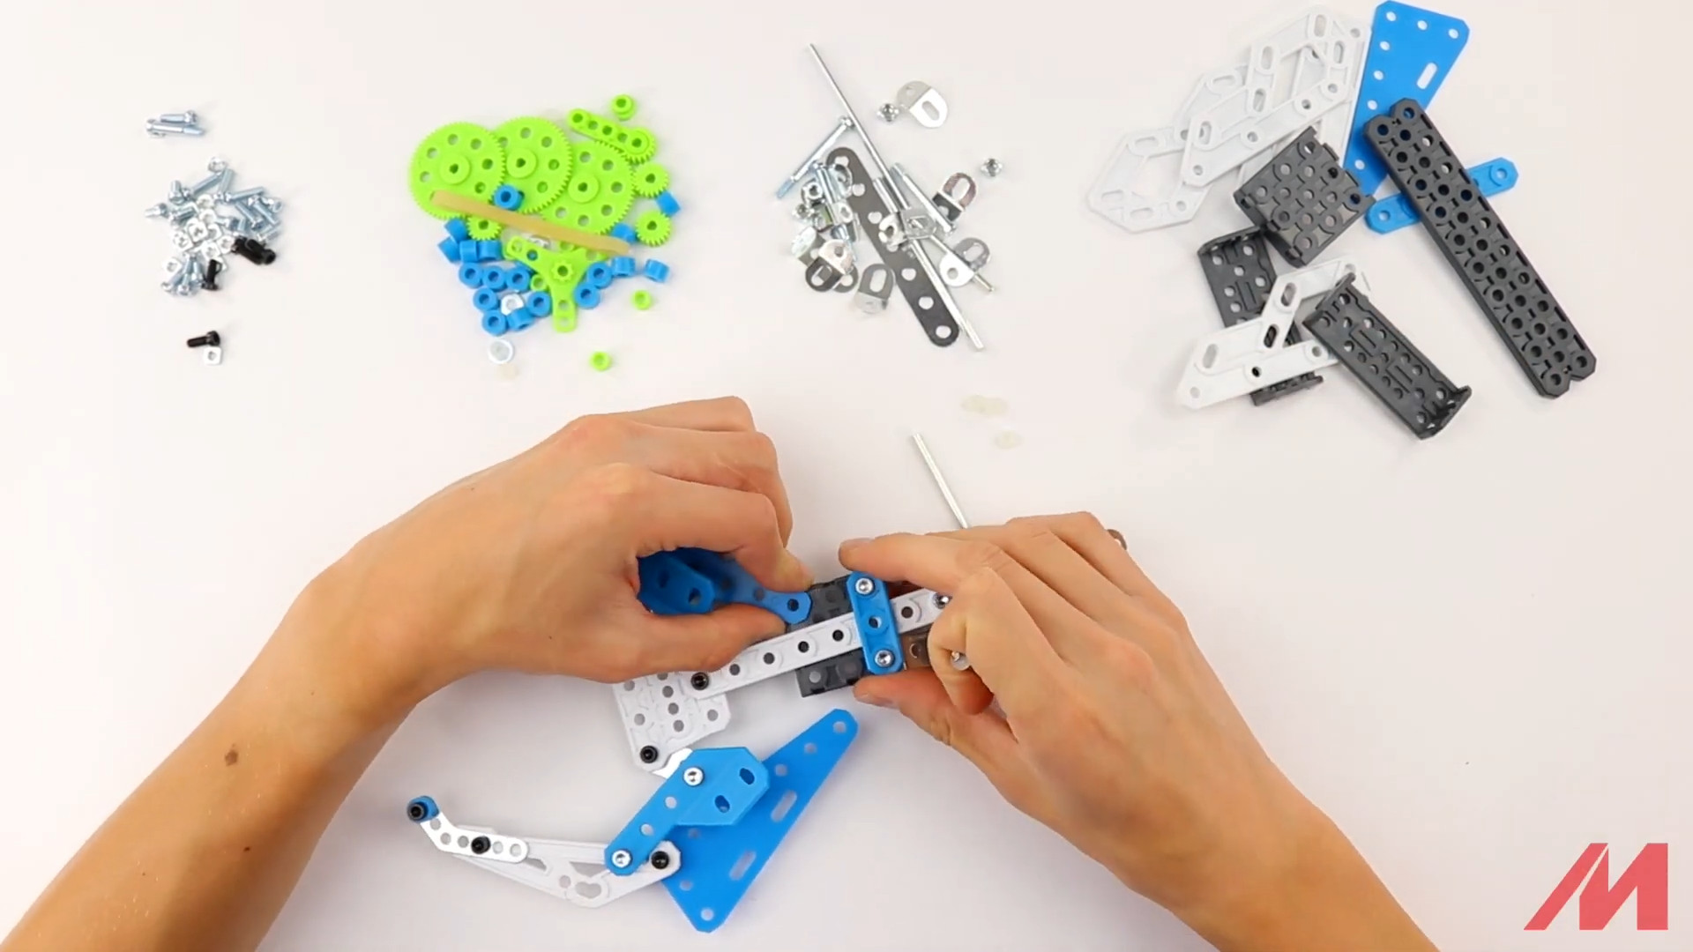
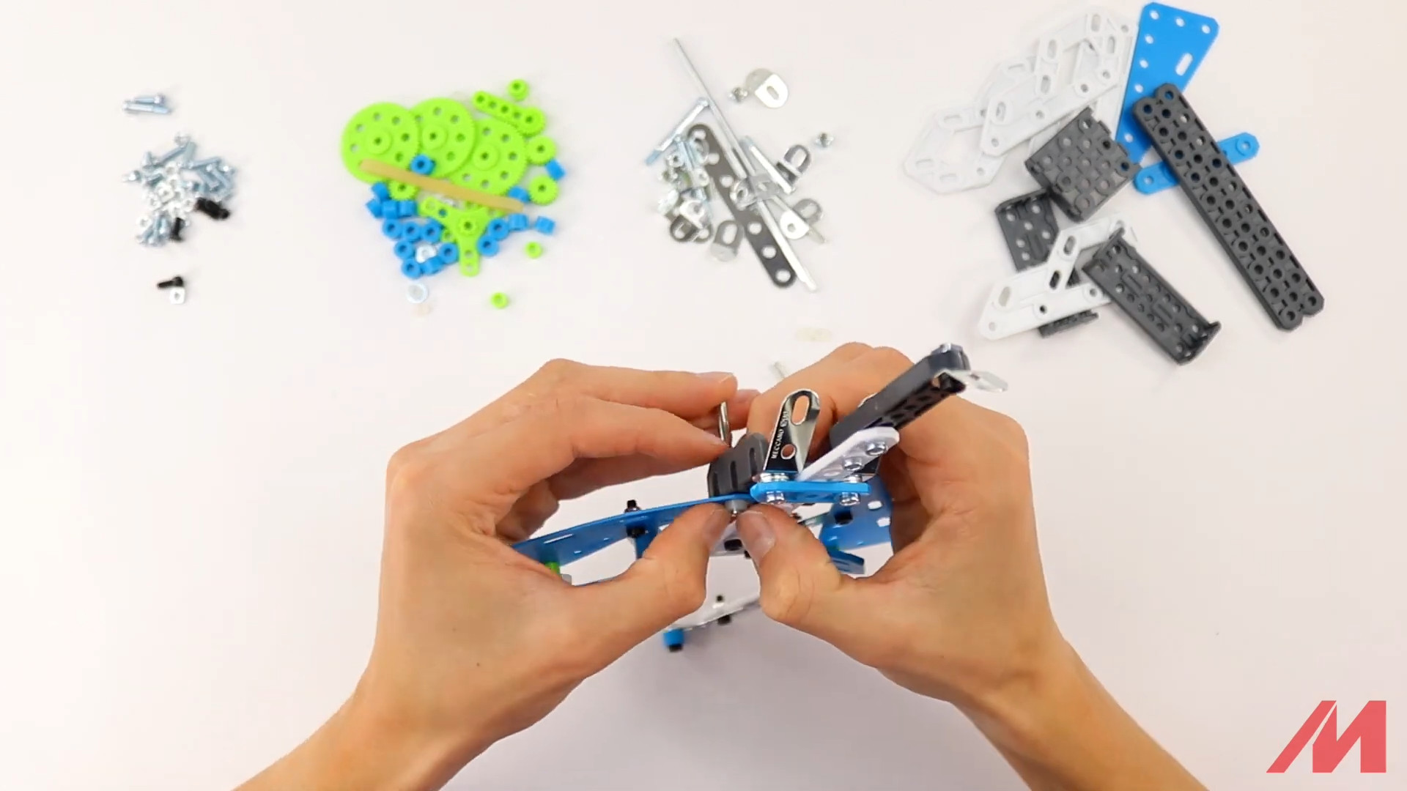
Step 7

Slide 27
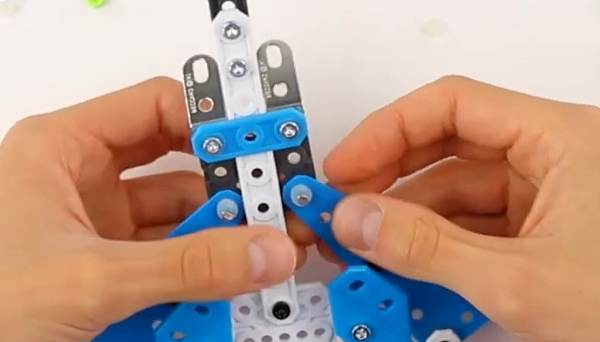
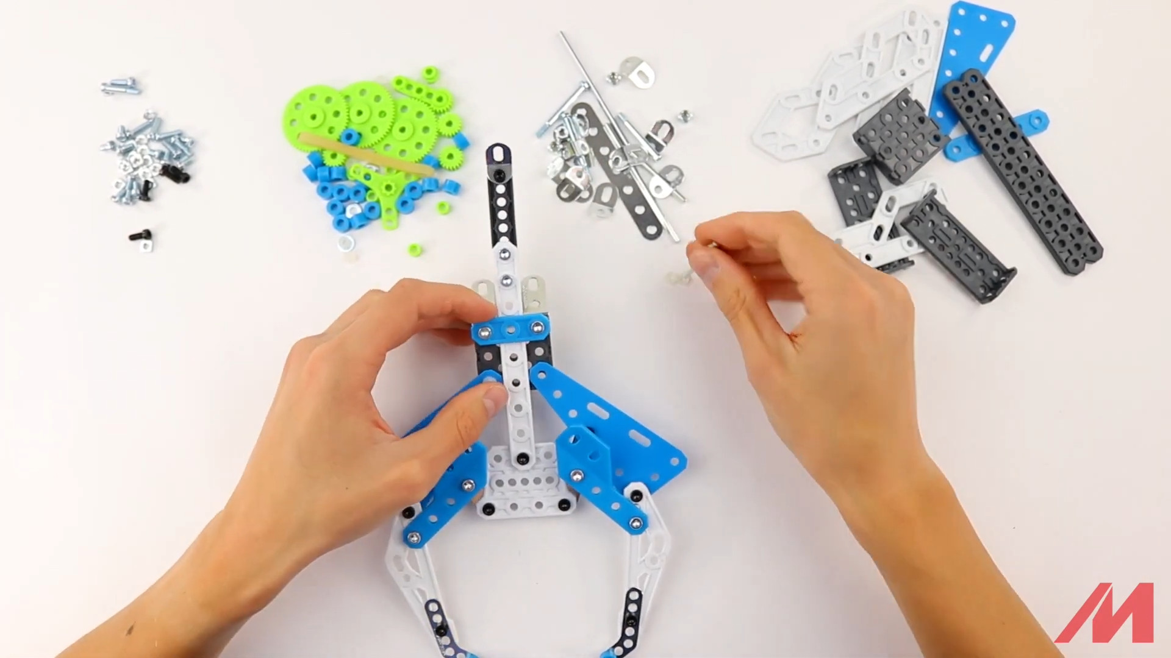
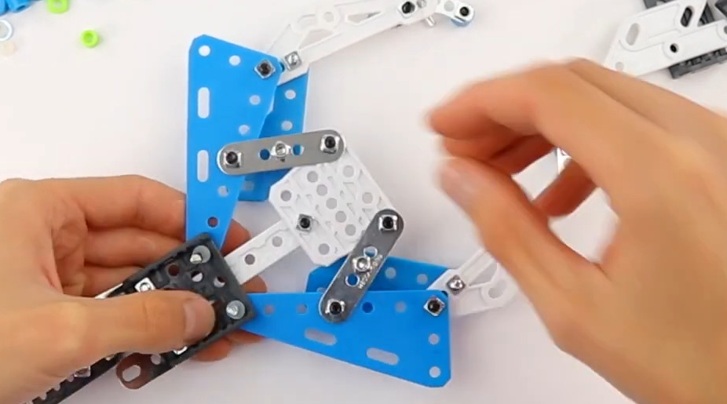
Step 7

Slide 28
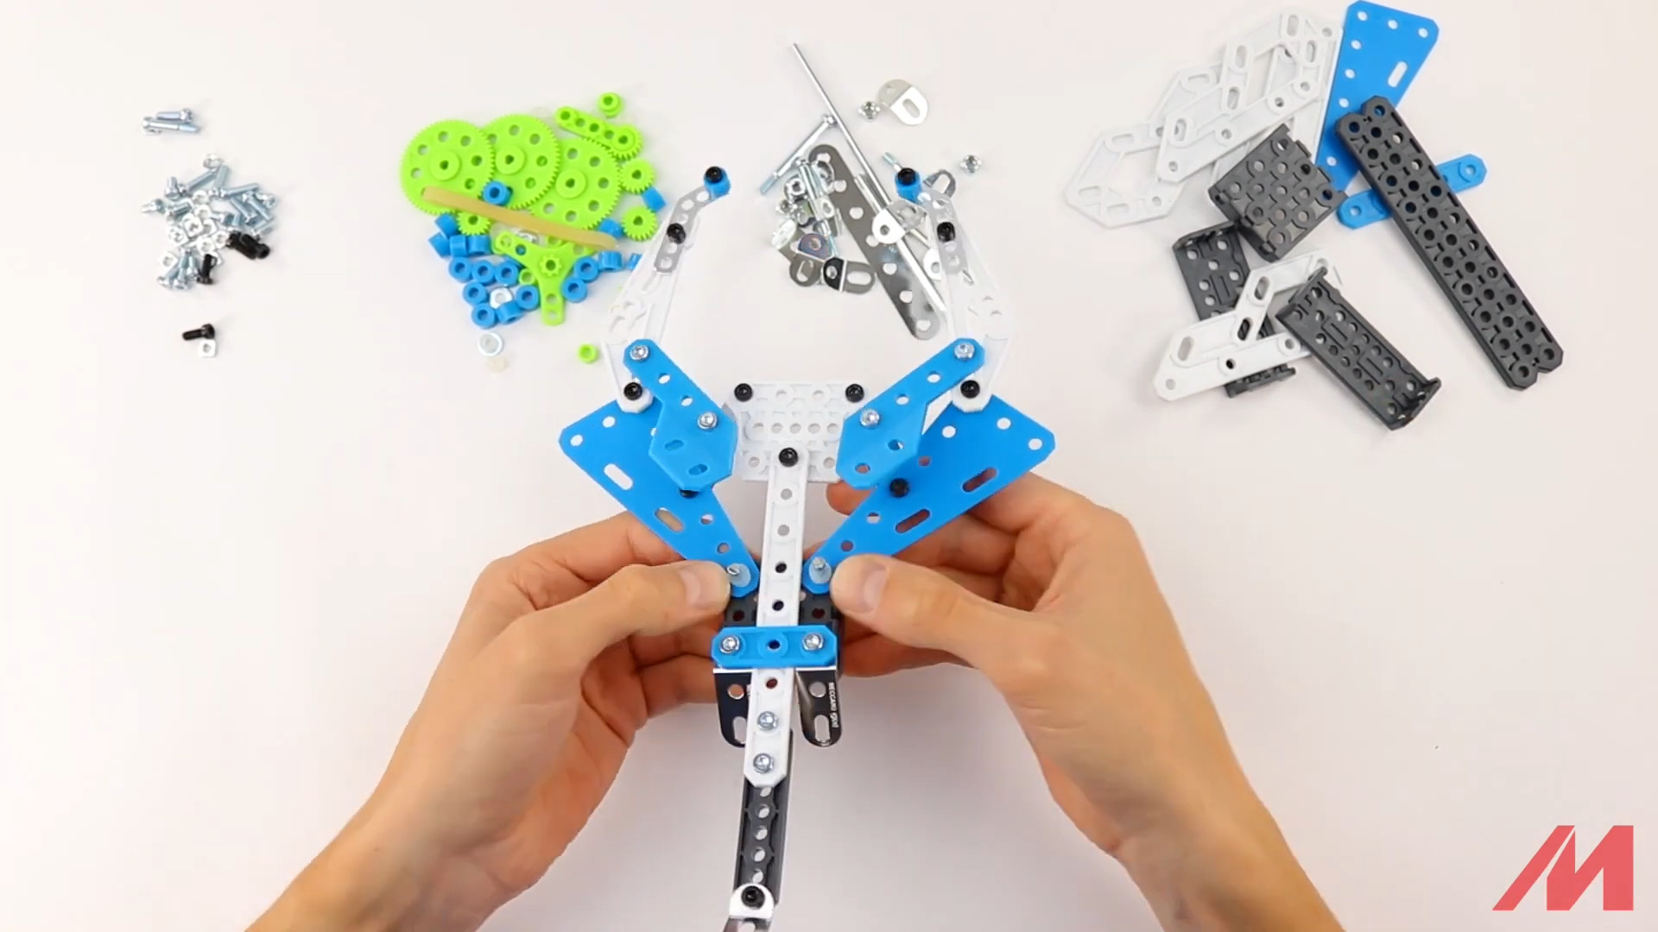
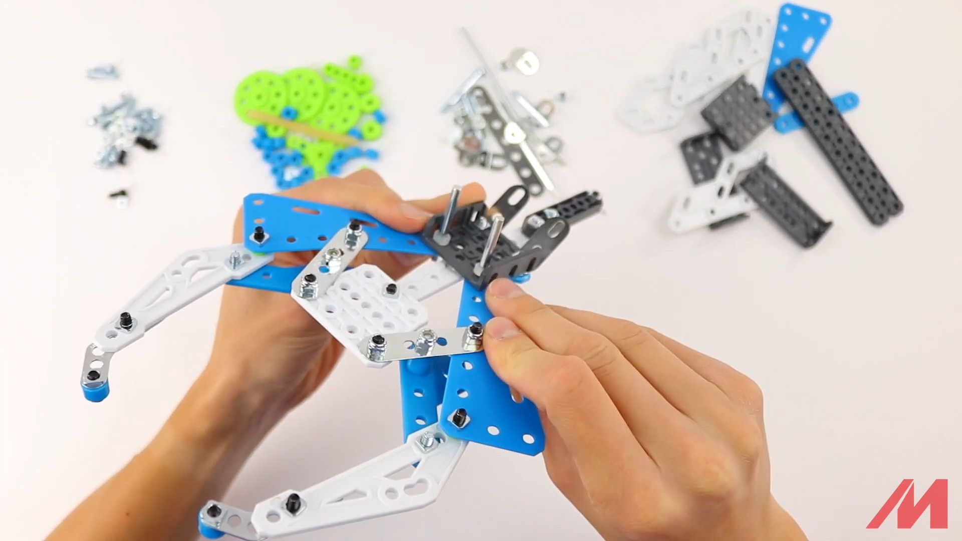
Step 7 – result

Slide 29
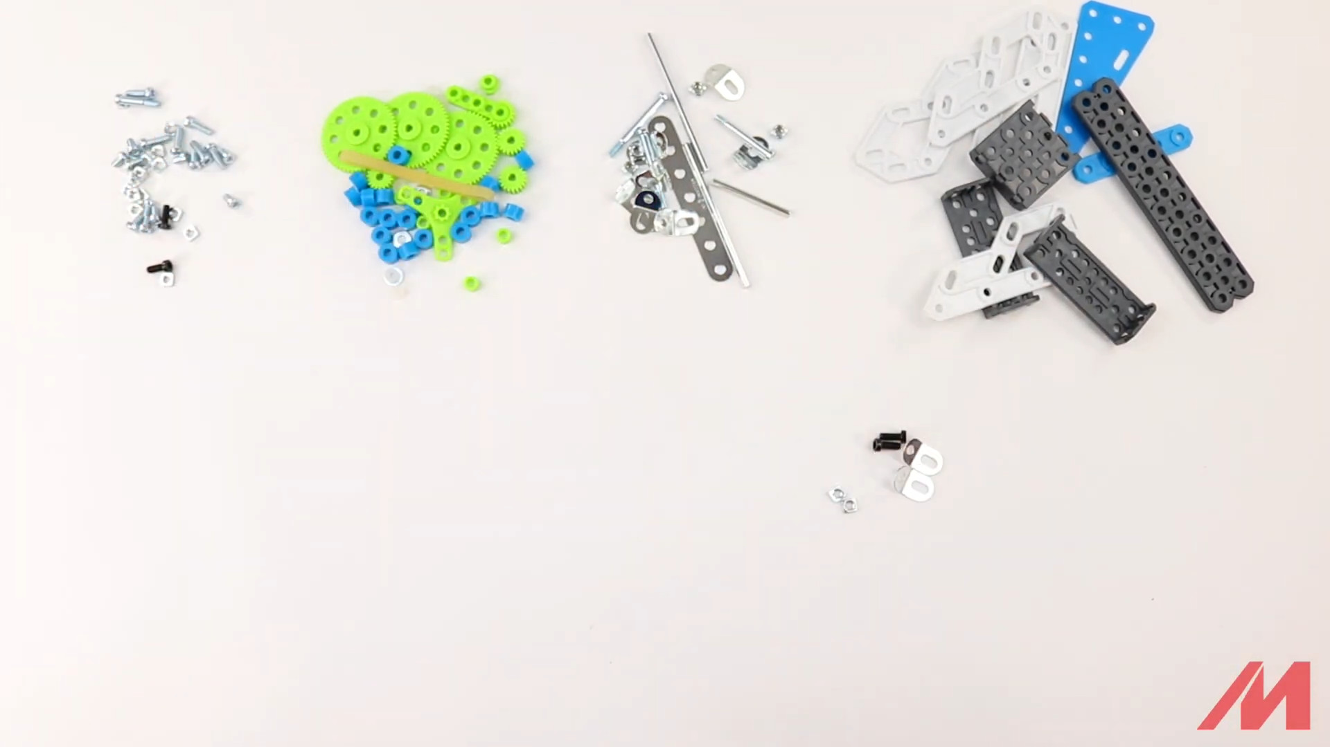
Step 8 – start
2x S2 bolts
2x A712 plied metal strips, obtuse angle
2x A337 nuts

Slide 30
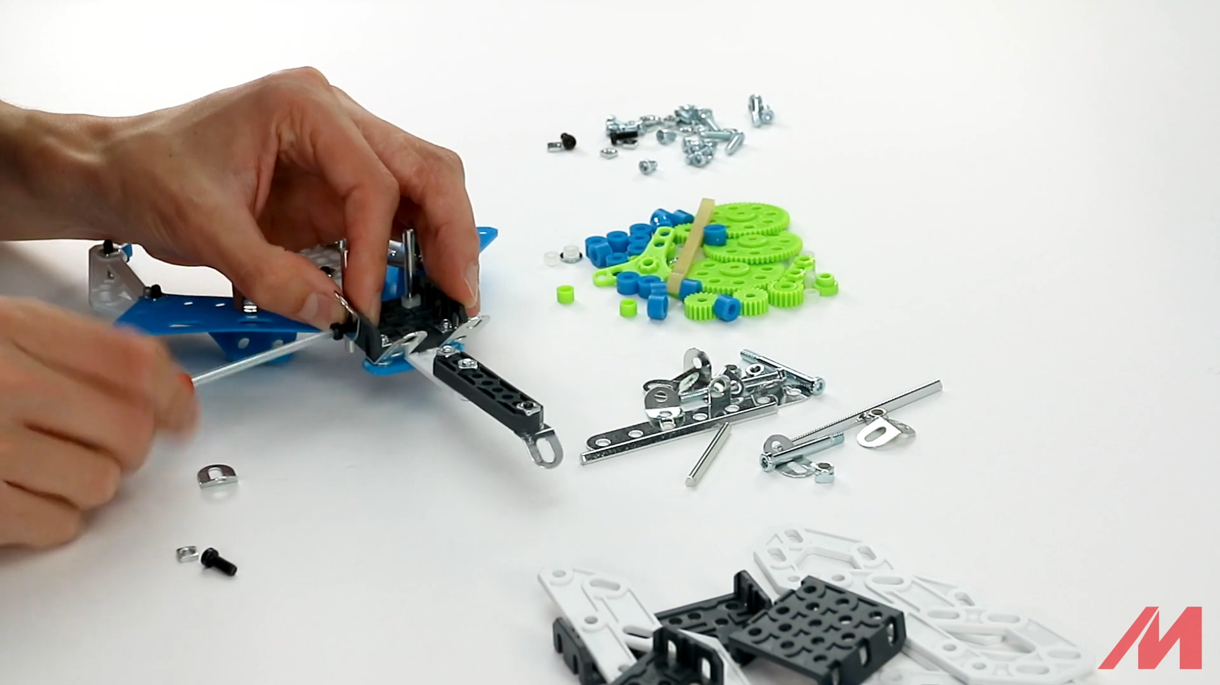
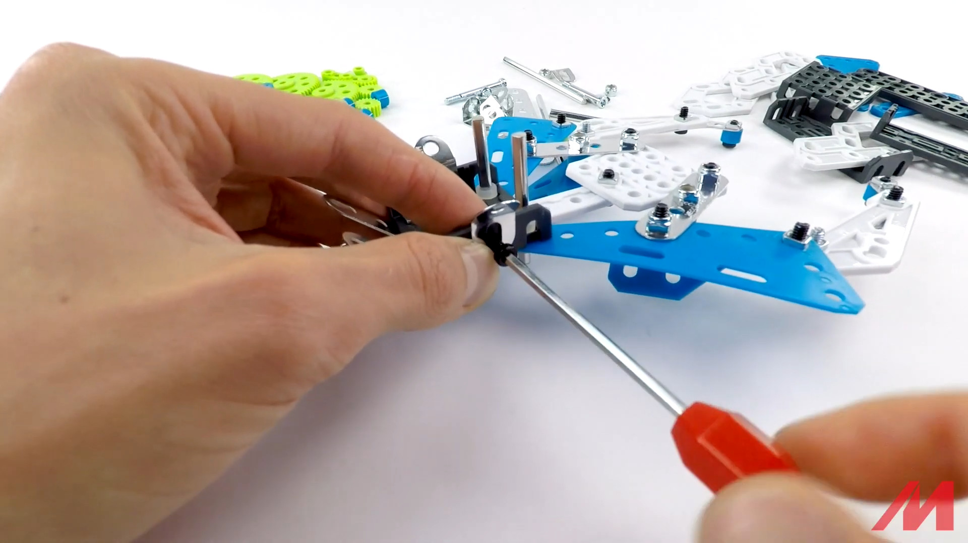
Step 8

Slide 31

Step 8 – result

Slide 32

Step 9 – start
2x S2 bolts
2x D023 white plastic pieces
2x A337 nuts

Slide 33


Step 9 x 2

Slide 34

Step 9 – result

Slide 35

Step 10 – start
1x D485 black plastic platform
2x S1 bolts
2x A337 nuts
2x A712 obtuse plied metal strips

Slide 36

Step 10 – result

Slide 37

Step 11 – start
2x S1 bolts
2x A337 nuts

Slide 38

Step 11 x2

Slide 39

Step 11 result

Slide 40

Step 12 – start

Slide 41

Step 12 – result

Slide 42

Step 13 – result

Slide 43

Scorpion ready!

